Slide 1


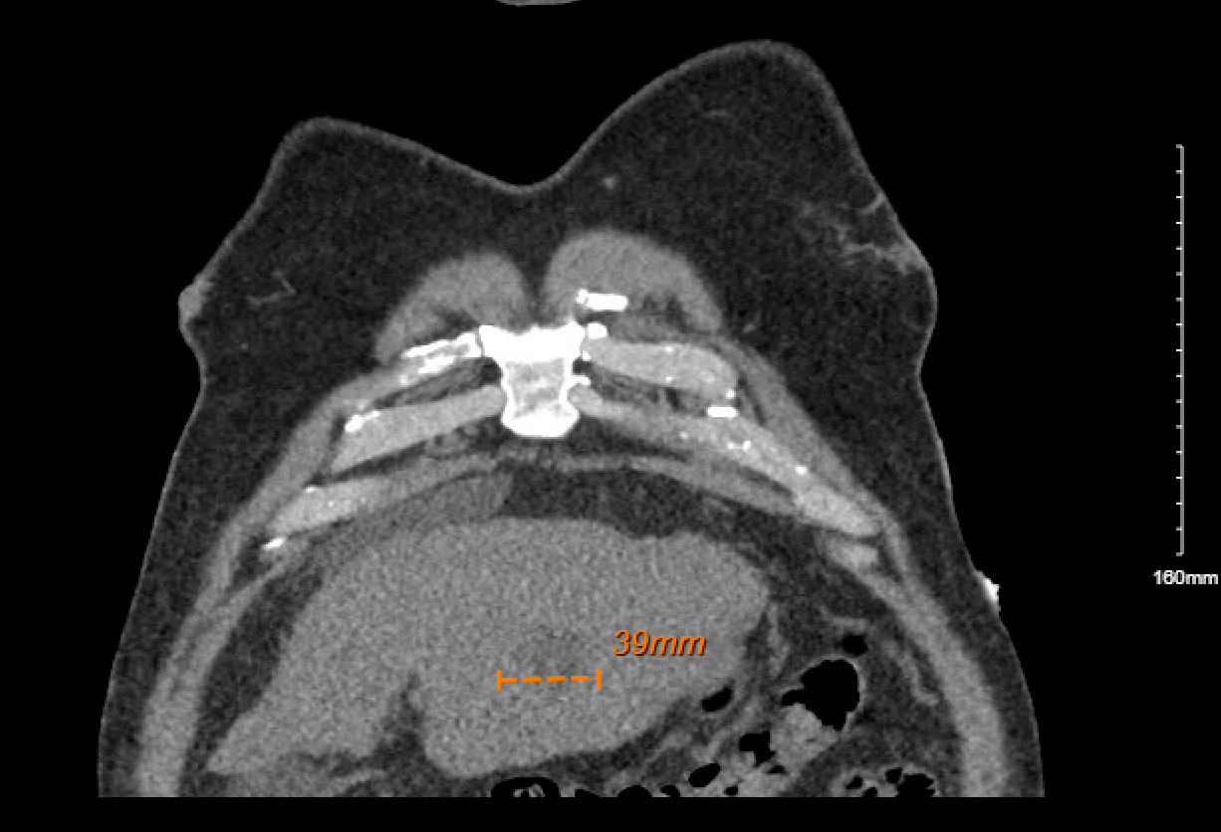
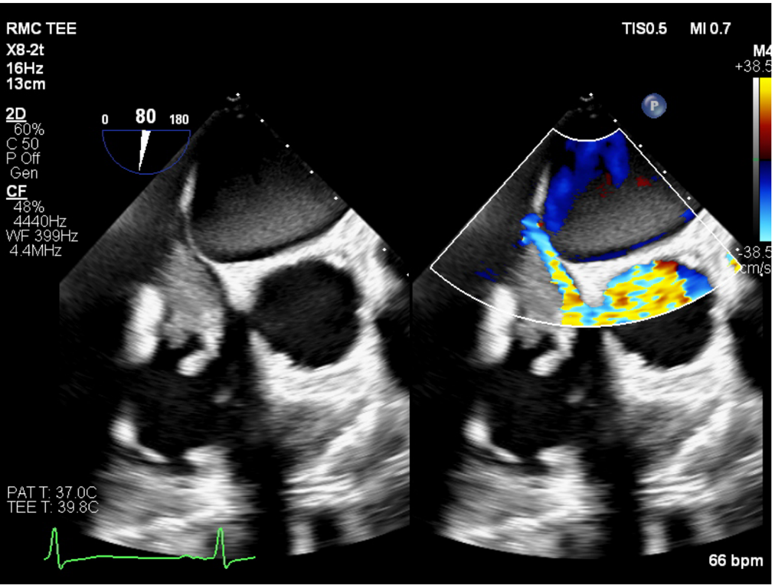
An RV Thrombus: Metastatic Hepatocellular Carcinoma
Riverside
Medical Center
Kankakee, Illinois
^{khamann@rhc.net}
Kyle Hamann, DO; Vijay Kata DO; Dhruv Joshi, DO, Nha Huynh, DO
Hepatocellular carcinoma (HCC) is not an uncommon malignancy widely known as one of the leading causes of cancer related deaths world wide. Throughout the variable course of disease, it is estimated that 30%-50% of HCC’s will develop extrahepatic metastasis [1]. Most commonly, metastasis will be restricted to nearby structures lowering the threshold of suspicion for distant involvement. In one literature review, the estimated incidence of cardiac involvement is roughly 6% via direct extension through the IVC [2]. We review a case in which a patient initially scheduled to undergo thrombectomy for presumed thrombus was correctly discovered to have cardiac involvement of metastatic HCC.
Case Summary
We present a 66 y/o male with chronic alcohol abuse and severe aortic regurgitation who presented to Riverside Medical Center after completion of an outpatient echocardiogram showing concern for right ventricular thrombus. On presentation, labs showed transaminitis with ALT 30, AST 69 and Tbil 1.6 concerning for alcoholic liver injury. Platelet level was 96 and INR elevated to 1.25. CTA chest and abdomen was completed showing a nodular contour of liver concerning for cirrhosis, esophageal varices, and a 3.9 cm heterogenous mass in the left hepatic lobe. Transesophageal echocardiogram and left heart catheterization were completed showing a 2.9 x 5.1 cm highly mobile, lobular mass attached to the intra-atrial septum possibly extending from the IVC concerning for thrombus. The patient was started on a heparin drip for anticoagulation and transferred to a tertiary care center with cardiothoracic surgery capabilities for thrombectomy as well as transthoracic aortic valve replacement due to severe aortic stenosis with aortic valve area of 1.1 cm . MRI liver completed which uncovered multifocal tumor burden in left hepatic lobe as well as tumor thrombus in left portal vein and perihilar portal venous confluence. AFP level was >2000. Repeat transesophageal echocardiogram was completed with updated read showing mass concerning for metastatic spread of HCC. CT surgery was aborted given patient prognosis.
Introduction
Figure 2: Lobulated hypodense mass left lobe segment 2/3 measures approximately 4.1 x 3.9, centimeters. Chronic stigmata of liver cirrhosis and left lobe HCC
Discussion
Our case highlights a rare presentation of metastatic carcinoma and how failure to recognize this disease process almost resulted in an unnecessary and high-risk surgical procedure.
Metastatic cardiac involvement due to HCC can also be used as a prognostic indicator. In one small study(n=8), mean survival time after discovery of cardiac involvement was 3.67 months[3].
As with all cancers, this case further exemplifies the importance of a multidisciplinary approach to effectively recognize, diagnose, and treat malignancy.
References:
1- Lyon PRP, Trevathan S, Talukdar R, Nguyen DD, McPhaul CM, Rampisela D. A Rare Case of Metastatic Hepatocellular Carcinoma to the Hard Palate. J Investig Med High Impact Case Rep. 2022 Jan-Dec;10:23247096221133989. doi: 10.1177/23247096221133989. PMID: 36300426; PMCID: PMC9619851.
2- Zhang, Xt., Li, Y., Ren, Sh. et al. Isolated metastasis of hepatocellular carcinoma in the right ventricle. BMC Cardiovasc Disord 19, 287 (2019). https://doi.org/10.1186/s12872-019-01290-6
3- George R. Marzouka, Apurva Badheka, Alexis P. Rodriguez, Sandra V. Chaparro, "Hepatocellular Carcinoma to the Right Ventricle", Case Reports in Cardiology, vol. 2014, Article ID 192737, 5 pages, 2014. https://doi.org/10.1155/2014/192737
Figure 1: A large multi-lobular and highly mobile thrombus or mass (measured 2.5cm x 5.0 cm) possible extended from the IVC and somewhat partially attached to the interatrial septum

