Slide 1


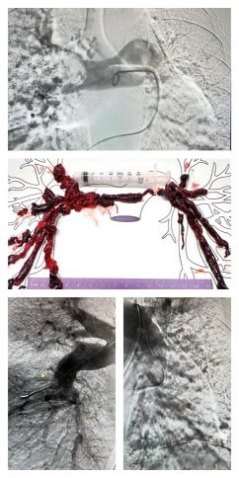
Treatment of Massive Pulmonary Embolism with Large-Bore Mechanical Thrombectomy
Riverside
Medical Center
Kankakee, Illinois
¹shassan@rhc.net
Seerat Hassan D.O. ¹Dureshahwar Ali D.O. ¹, Brett Ploussard D.O.¹, Amit Zachariah MD ¹
Riverside Medical Center, Heart and Vascular Institute; Kankakee, Illinois
Background
This case shows that treatment of massive pulmonary embolism with mechanical thrombectomy utilizing FlowTriever device can result in immediate improvement in oxygenation, hemodynamics, and relief of right heart strain, without thrombolytic therapy.
Percutaneous thrombectomy devices are an effective treatment alternative to catheter directed thrombolysis or systemic anticoagulation, especially in patients with high bleeding risk
Figure 1
Emerging technologies are increasing the role of percutaneous mechanical thrombectomy (PMT) when managing intermediate-high risk pulmonary embolism in select patient populations. We present a case of successful PMT in a patient with massive pulmonary embolism and high bleeding risk.
Case Presentation
44-year-old female presented following a motor vehicle accident with traumatic odontoid fracture and minor contusions treated with conservative medical management inpatient rehabilitation. On day 5, she experienced an in-hospital syncopal episode with hypotension. CT angiography revealed massive saddle pulmonary embolism with right heart strain. Transthoracic echocardiogram showed severely dilated RV with TAPSE=1.22 cm and S'=7.46 cm/s and estimated pulmonary artery pressure of 45 mmHg. BNP 106, HS-troponin 205.
Decision-Making
Given high-bleeding risk due to recent trauma and presence of thrombocytopenia, a multidisciplinary consensus decision was to proceed with mechanical thrombectomy. PMT was performed with a 24 French Inari FlowTriever thrombectomy catheter with great results without any complications. Patency of both pulmonary arteries, improvement of RV size and function (TAPSE = 1.91 cm and S’ = 10.7, significant drop in pulmonary pressures and hemodynamic stability were achieved post-thrombectomy.
Pulmonary angiography depicting bilateral massive pulmonary embolism with visualized significant thrombus burden in the right truncus anterior and in the left middle lobar branches.
Central image shows extracted thrombus from the right and left pulmonary arteries. Bottom two images display pulmonary angiography after thrombectomy
Conclusions
Systemic thrombolytics present a significant bleeding risk in some patients. However, PMT is effective in removing obstructing thrombi from major pulmonary arteries to facilitate rapid improvement in hemodynamics.
Disclosure Information
There are no disclosures for any any authors

