Slide 1


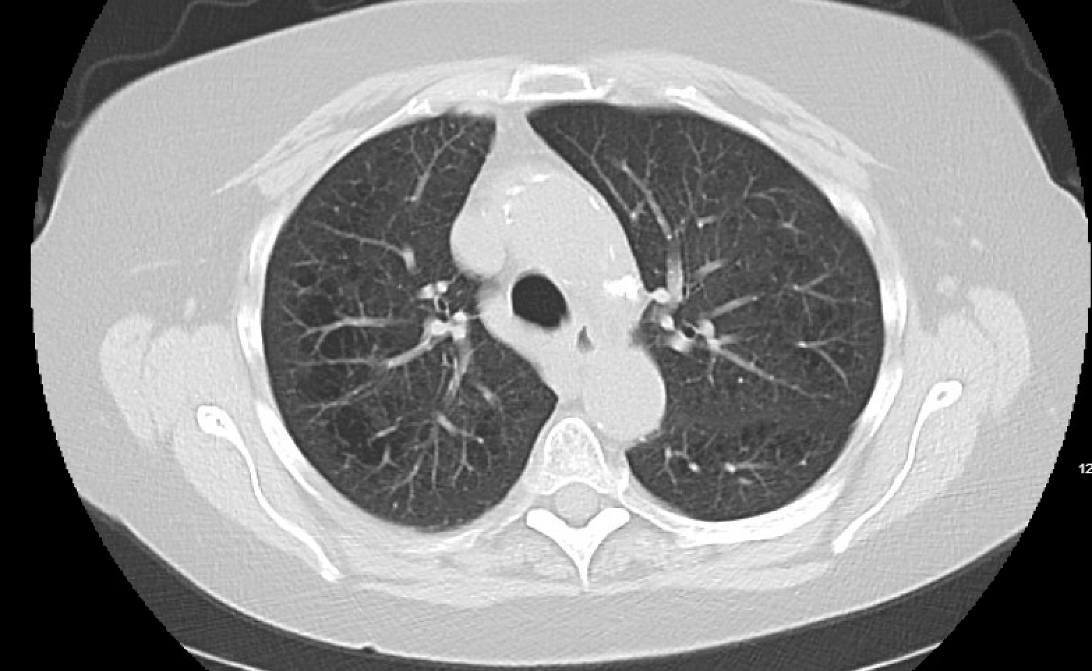
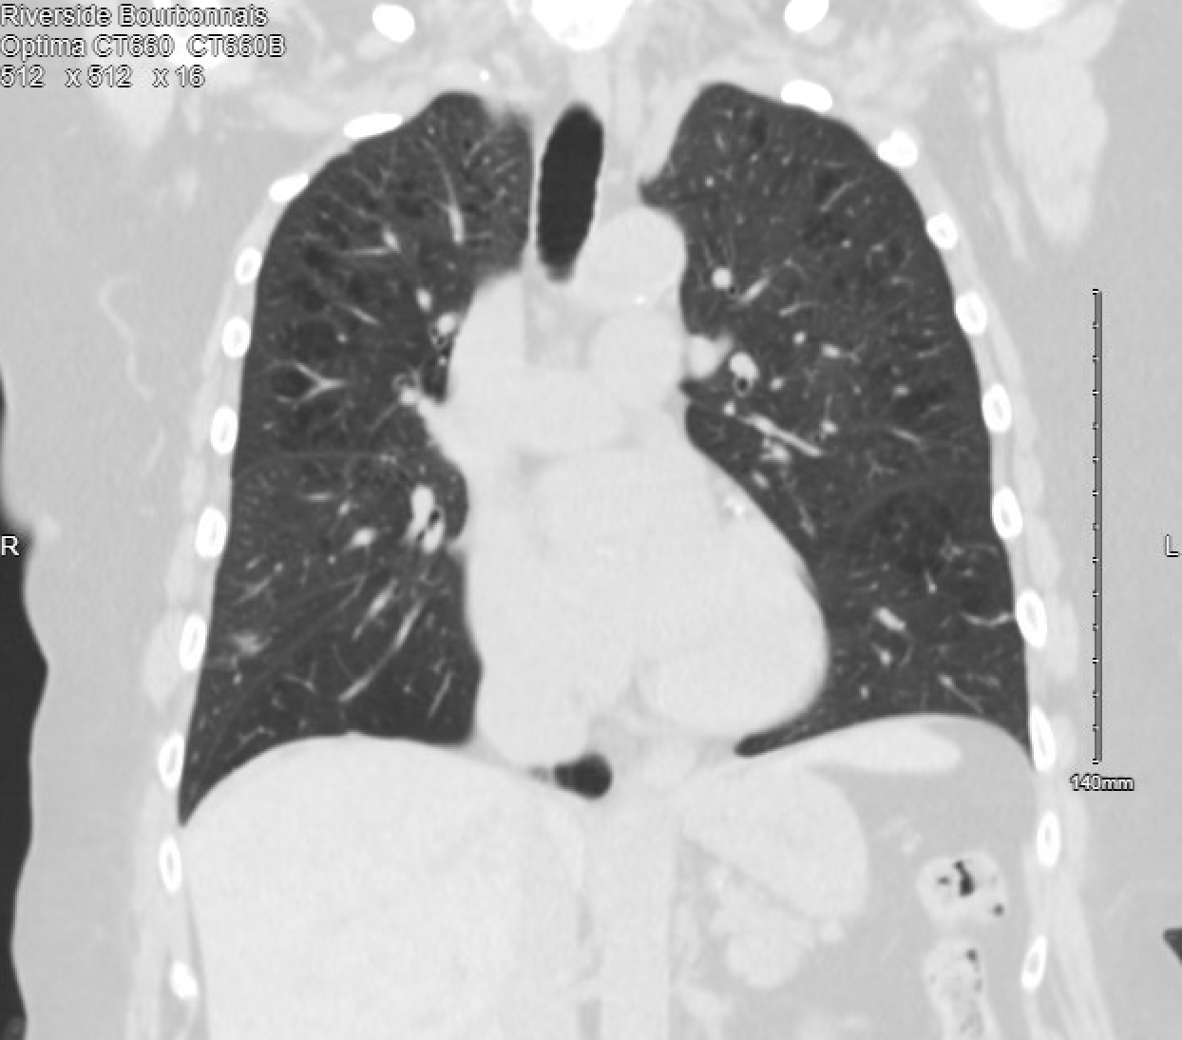

Unraveling the mystery of Idiopathic CD4+ T cell lymphocytopenia: A case report of unexplained immunodeficiency
Riverside
Medical Center
Kankakee, Illinois
^{sjain@rhc.net}
Shreya Jain, DO; Sasha Singh, DO
Pneumocystis jiroveci pneumonia is a serious life threatening disease that usually occurs in patients with human immunodeficiency virus (HIV). This is a case of a patient who did not have HIV or other known risk factors.
Discussion
This case underscores the importance of recognizing and investigating unusual presentations of immunodeficiency, particularly in patients with predisposing factors such as advanced age and chronic respiratory conditions like COPD. In the presumably immunocompetent patient, it is unexpected to find PJP who does not have history of HIV, history of organ transplant, chemotherapy, prolonged glucocorticoid use. Early recognition and awareness of PJP pneumonia is essential to prevent morbidity and mortality. The occurrence of PJP in the absence of conventional risk factors necessitated a thorough evaluation, ultimately revealing the presence of ICL. ICL is a rare syndrome characterized by a low CD4+ T cell count in the absence of HIV infection or other known causes of immunodeficiency.
ICL remains a diagnostic challenge, requiring a high index of suspicion and thorough evaluation to exclude other causes of immunodeficiency. Prompt recognition and treatment of opportunistic infections are essential in improving patient outcomes. Further research is needed to elucidate the pathogenesis of ICL and optimize therapeutic strategies for this rare syndrome.
Introduction
Conclusion
Case Summary
Patient is a seventy-two year old female, former smoker with about an eighty-two pack year smoking history and severe COPD, who initially presented to her pulmonologist office for a follow up appointment for chronic daily cough with chronic hypoxic respiratory failure on 2 liters nasal cannula with history of histoplasmosis in the eye. CT lung cancer screening showed multiple lung nodules - twenty millimeter solid nodule in left upper lobe (LUL), fourteen millimeter irregular shaped nodules in left lower lobe (LLL), fifteen millimeter nodule in super segment of right lower lobe (RML), and eleven and fifteen millimeter nodule in right lower lobe (RLL). Subsequently, PET scan showed multiple solid mixed density nodules, low level metabolic activity, and some areas of calcifications. Biopsy of left upper lobe nodule was negative for histoplasma. Interventional radiology performed CT guided needle biopsy of lung nodules, which showed fibrosis, lymphocytic and granulomatous inflammation without malignancy. Serologies for histoplasma and blastomyces were negative. Repeat CT chest showed double in size of right lower lobe nodule. Bronchoscopy obtained a biopsy from the RML began to bleed and was treated with robotic catheter tranexamic acid, cold saline, and epinephrine. Unable to obtain a biopsy from the RLL due to significant bleeding. Bronchoscopy cultures grew positive for pneumocystis jiroveci pneumonia. CD4 count was low. Patient was started on atovaquone instead of trimethoprim-sulfamethoxazole due to allergy to sulfa drugs. Patient was referred to an immunologist for concern of idiopathic CD4+ T cell lymphocytopenia. After treatment, the patient no longer had bloody sputum and the repeat CT chest showed smaller lung nodules.
Figure 1 and 2 show multiple bilateral pulmonary nodules, specifically lingular and left lower lobe nodules. Dominant 2 cm stellate nodule in right lower lobe has decreased in size. Stellate 13mm nodules in right middle lobe is unchanged. No new nodules.
References:
References:
1Ahmad, D. S., Esmadi, M., & Steinmann, W. C. (2013). Idiopathic CD4 Lymphocytopenia: Spectrum of opportunistic infections, malignancies, and autoimmune diseases. Avicenna Journal of Medicine, 03(02), 37–47. https://doi.org/10.4103/2231-0770.114121
Smith, D. K., Neal, J. J., & Holmberg, S. D. (1993). Unexplained opportunistic infections and CD4+ T-lymphocytopenia without HIV infection. An investigation of cases in the United States. The Centers for Disease Control Idiopathic CD4+ T-lymphocytopenia Task Force. The New England Journal of Medicine, 328(6), 373–379. https://doi.org/10.1056/NEJM199302113280601

