Slide 1


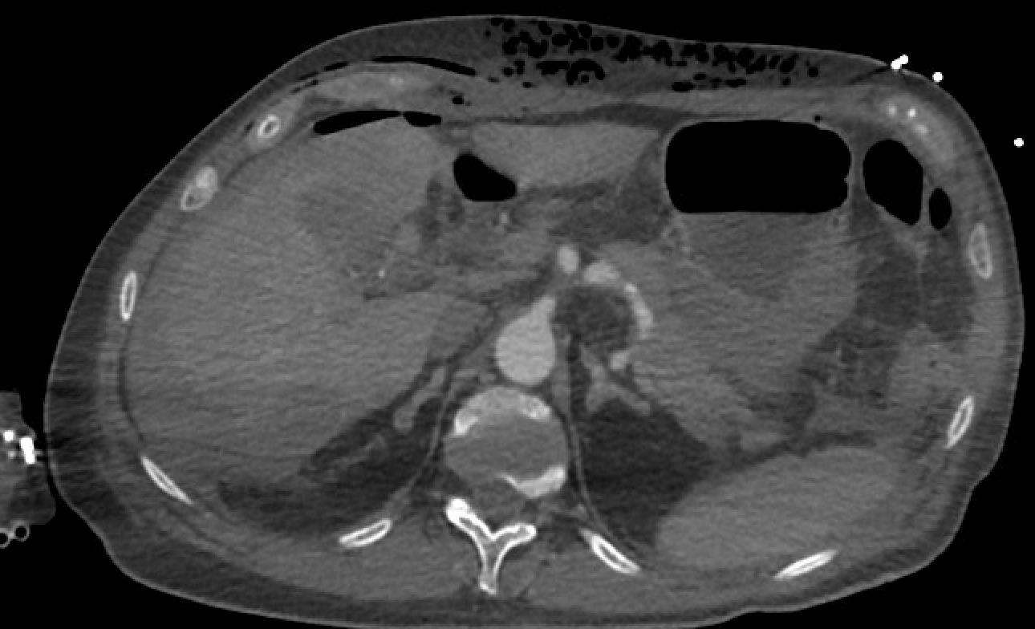
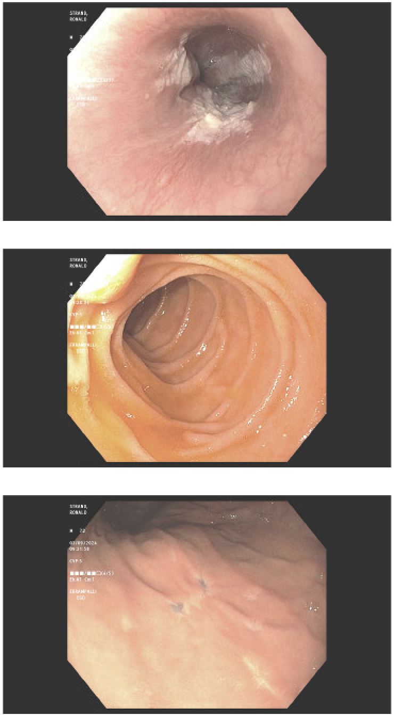
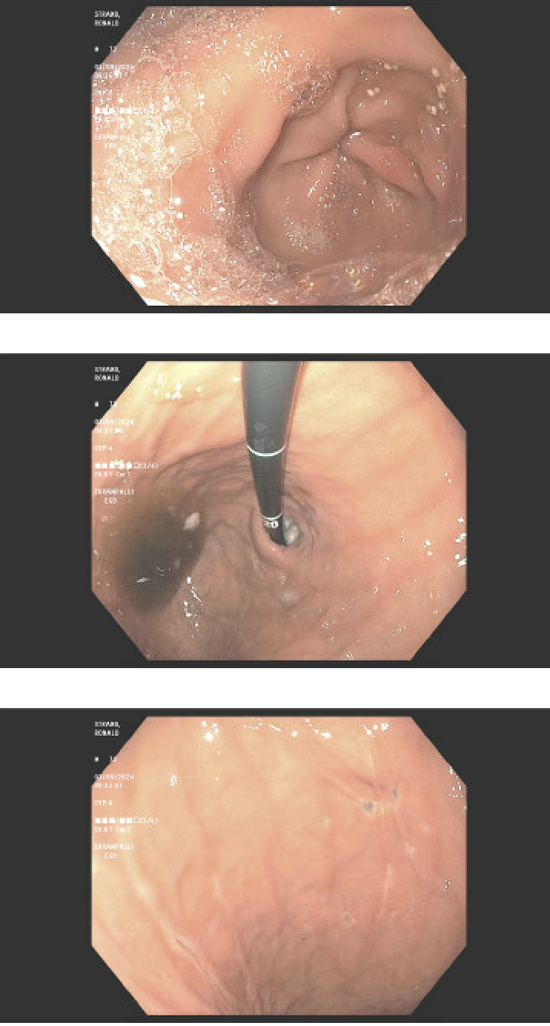

Unraveling the complications of Acute Cholecystitis: A
Case report of Hemoperitoneum leading to gastric ulcerations
Riverside
Medical Center
Kankakee, Illinois
^{sjain@rhc.net}
Shreya Jain, DO; Vijay Kata, MD, Thomas O’Connor, MD; Gretchen Williams, DO
Acute cholecystitis is a common surgical emergency characterized by inflammation of the gallbladder. While cholecystectomy is the definitive treatment, complications can occur, including bleeding, hemoperitoneum, and gastric ulcerations. We present a case highlighting the diagnostic and management challenges posed by these complications in a complex patient with multiple comorbidities.
Discussion
The occurrence of rare complications such as cystic artery pseudoaneurysm leading to hemoperitoneum post-laparoscopic cholecystectomy is an uncommon but potentially life-threatening event. The development of hemoperitoneum in the context of cystic artery pseudoaneurysm is a rare phenomenon. Gastric ulcerations secondary to hemoperitoneum are a rare but recognized complication, involving a combination of factors, including chemical irritation from blood in the peritoneal cavity, stress-induced gastric mucosal injury, and compromised mucosal blood flow due to hypovolemia.
Complications of acute cholecystitis, including hemoperitoneum and gastric ulcerations, can pose significant diagnostic and management challenges. Prompt recognition and intervention are essential to prevent adverse outcomes in these patients.
Introduction
Conclusion
Case Summary
A seventy-two-year-old male with a history of ESRD on HD, CVA, and atrial flutter on Eliquis presented with persistent nausea and vomiting. Ultrasound revealed acute cholecystitis, prompting elective cholecystectomy. Within a day of surgery, patient developed hematemesis and repeat imaging demonstrated hemoperitoneum and subcapsular hematoma, concerning for active bleed. Patient required emergent cystic artery embolization. Patient’s vitals and labs remained stable and he was discharged from the hospital, however returned within less than a week due to hematemesis. CT angiogram of abdomen and pelvis revealed active extravasation in stomach on arterial phase along the lateral wall with improvement in subcapsular hematoma and hemoperitoneum. Patient required urgent upper endoscopy, which revealed multiple ulcers (7) in the stomach, managed with hemospray. Patient was kept intubated in ICU due to high risk of rebleed and placed on protonix drip. There was a slow downtrend in hemoglobin and patient required 1 unit of blood transfusion. Afterwards, patient was stabilized with no further bleeding episodes.
Figure 1 above shows subcapsular hematoma on left side of image and hemoperitoneum in the darkened area. Cystic artery pseudoaneurysm 10 x 13 x 9 cm enhancing focus adjacent to the surgical clips in the gallbladder also notable
Figure 2. Images on the right show images taken during upper endoscopy. The bottom two images reveal multiple ulcers in stomach that were managed with hemospray. Proximal and distal esophagus noted in previous images did not show evidence of acute bleeding.
References:
Carey, F., Rault, M., Crawford, M. et al. Case report: cystic artery pseudoaneurysm presenting as a massive per rectum bleed treated with percutaneous coil embolization. CVIR Endovasc 3, 8 (2020).
https://doi.ord/10.1186/s42155-019-0090-0
Anand U, Thakur SK, Kumar S, Jha A, Prakash V. Idiopathic cystic artery aneurysm complicated with hemobilia. Ann Gastroenterol. 2011;24(2):134-136. PMID: 24714720; PMCID: PMC3959291.
Saluja, S.S., Ray, S., Gulati, M.S. et al. Acute cholecystitis with massive upper gastrointestinal bleed: A case report and review of the literature. BMC Gastroenterol 7, 12 (2007). https://doi.org/10.1186/1471-230X-7-12

