Slide 1


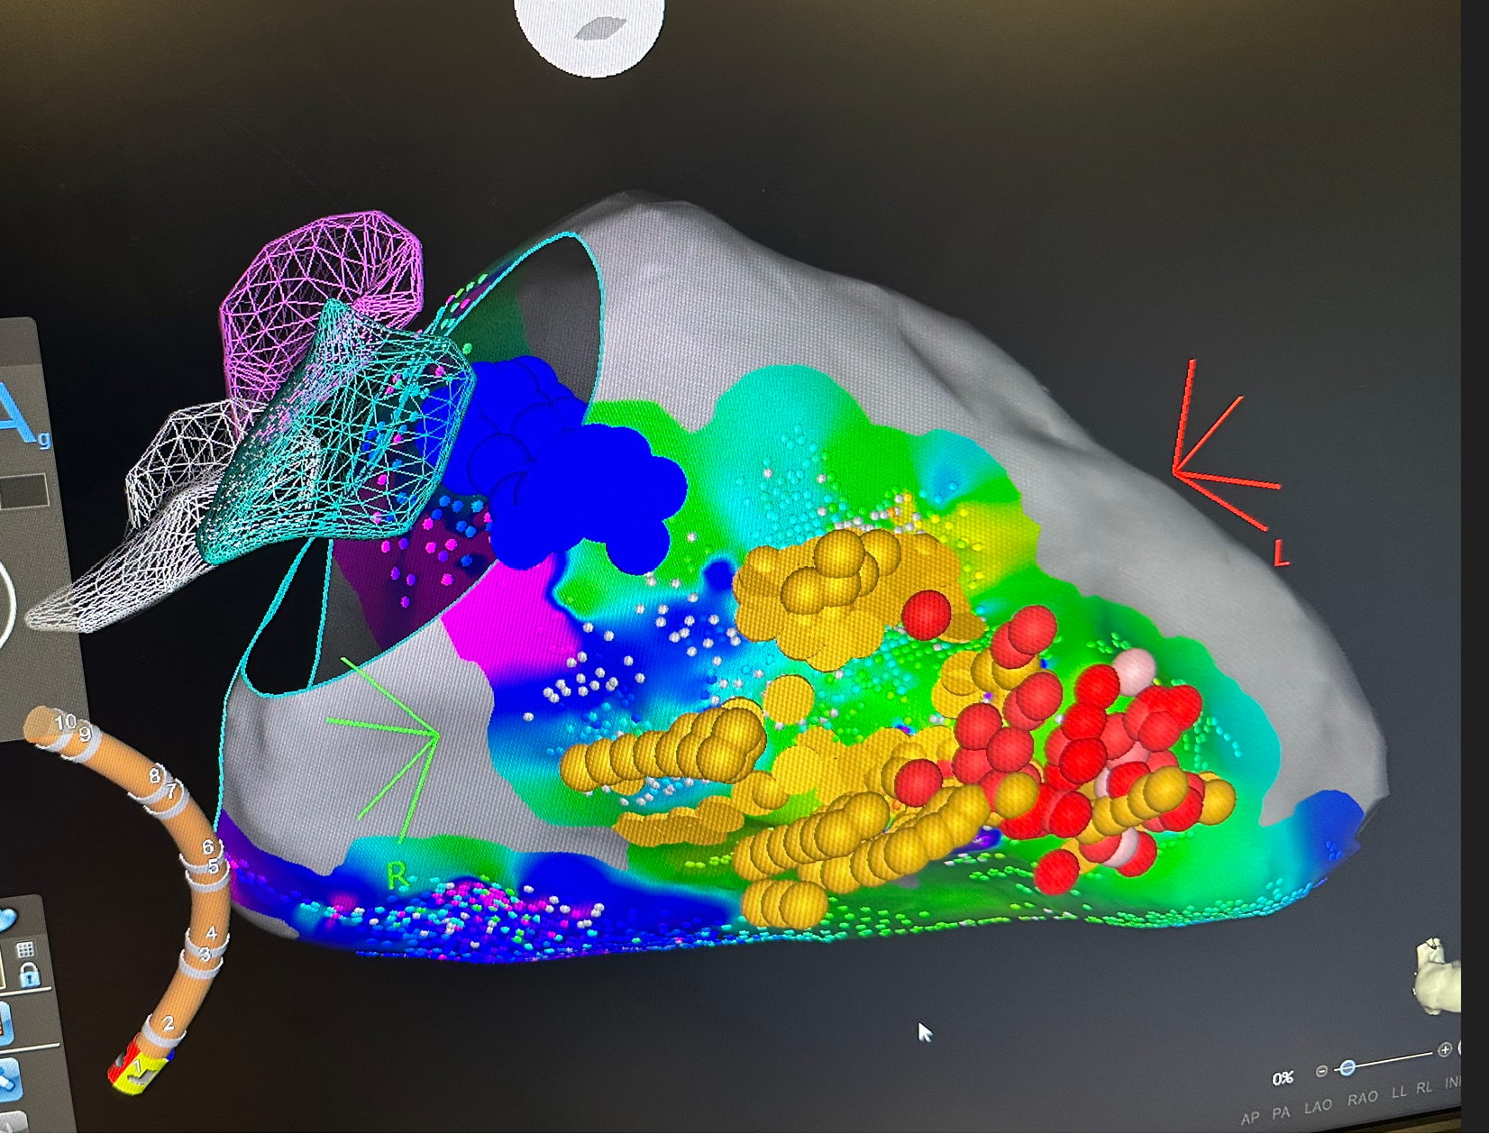
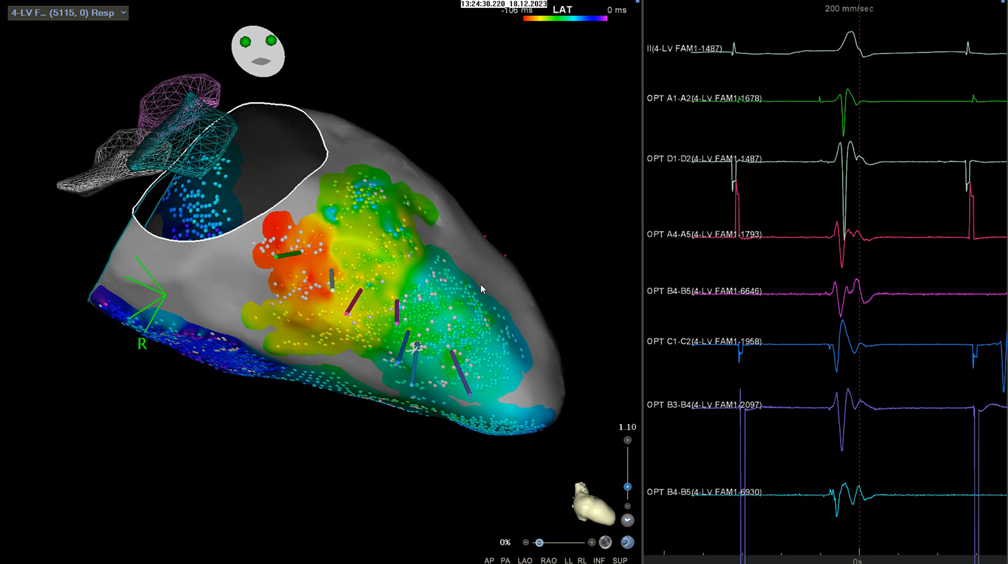
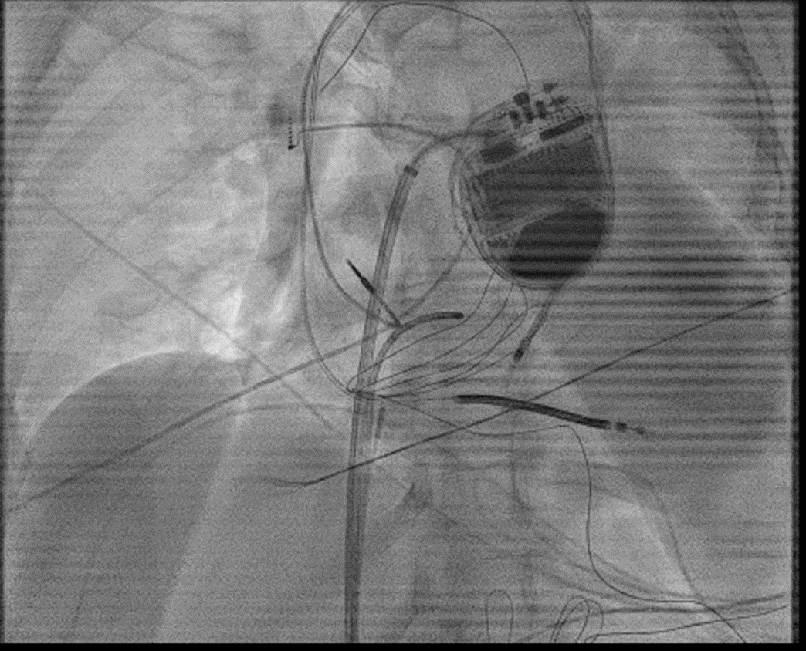
Purkinje Network Modification Utilizing the High Density OPTRELL Mapping Catheter
Riverside
Medical Center
Kankakee, Illinois
¹smuralidhara@rhc.net
Suchitra Muralidharan¹, MD; Vivek V. Reddy, MD
Idiopathic ventricular fibrillation is the presence of VF in the absence of known structural heart disease. Ablation of distal Purkinje potentials has been shown to reduce the risk of recurrent VF. While mapping of these potentials has been traditionally performed by a linear mapping catheter, we describe the utilization of the high density OPTRELL mapping catheter for fast and accurate identification of Purkinje potentials.
Blue dots: indicating proximal His bundle, left bundle
Yellow dots: indicating left anterior and left posterior fascicle
Red dots: show distal conduction system where ablation was performed
Conclusion
Purkinje network modification for the purposes of idiopathic VF ablation has shown increasing promise and efficacy. In the majority of these cases, mapping appears to be via a retrograde approach utilizing a linear mapping catheter. We describe the efficacy of the high-density OPTRELL mapping catheter via a transseptal approach for annotation of the conduction system. Of note, due to the small sharp pre-potentials present in the distal conduction system, manual points are required at present time as opposed to an automatic annotation system. Since ablation, there has been no recurrence of VF with discontinuation of amiodarone.
Background
Objective
A detailed map of the left anterior fascicle, left posterior fascicle and distal Purkinje system performed via the OPTRELL catheter and CARTOSOUND module is noted in figure 1. Manual annotation points were taken. Prior to ablation, aggressive ventricular and atrial burst pacing as well as extra stimuli did not induce VF. Subsequently as previously described in prior manuscripts, ablation of the distal Purkinje network was performed while avoiding the left anterior and posterior fascicle ( LAF and LPF ). Utilizing the high density OPTRELL mapping catheter, we were easily able to identify the LAF and LPF as well as distal Purkinje network.
(a)
(b)
(a) CARTO-SOUND map indicating conduction system with the OPTRELL mapping catheter
(b) Fluoroscopic image of ablation catheter near LPF

