Slide 1



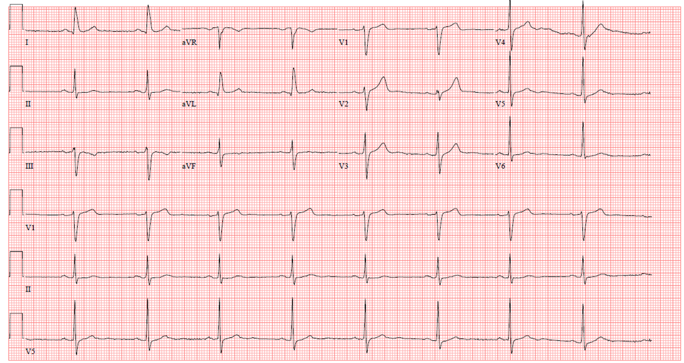

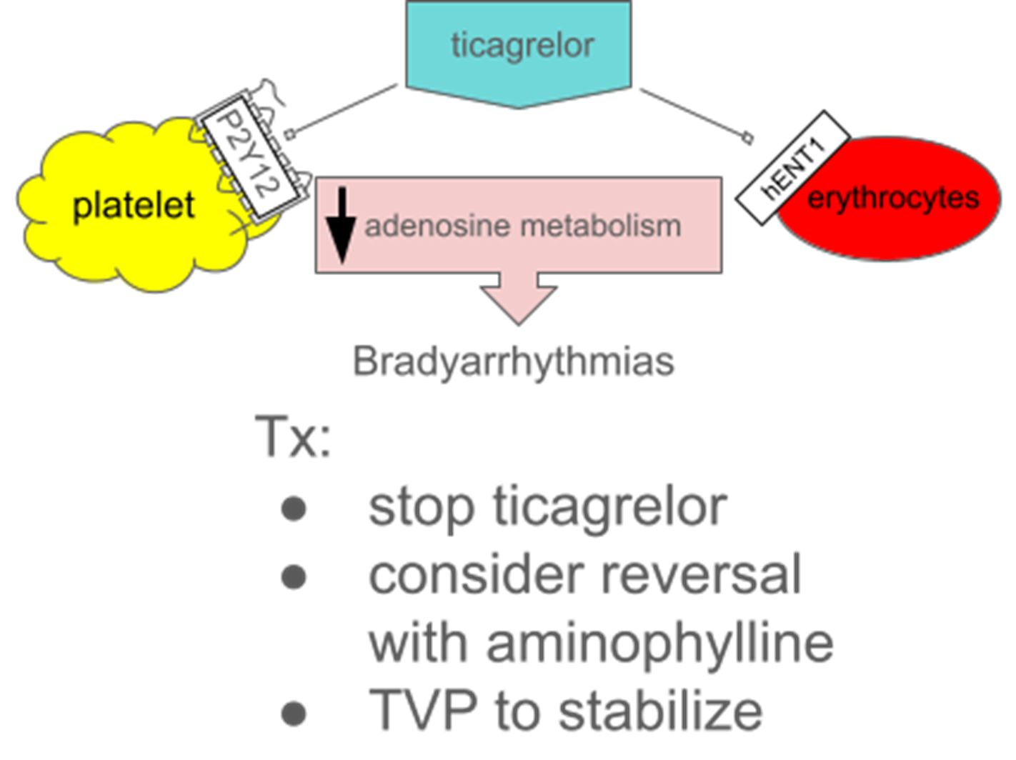
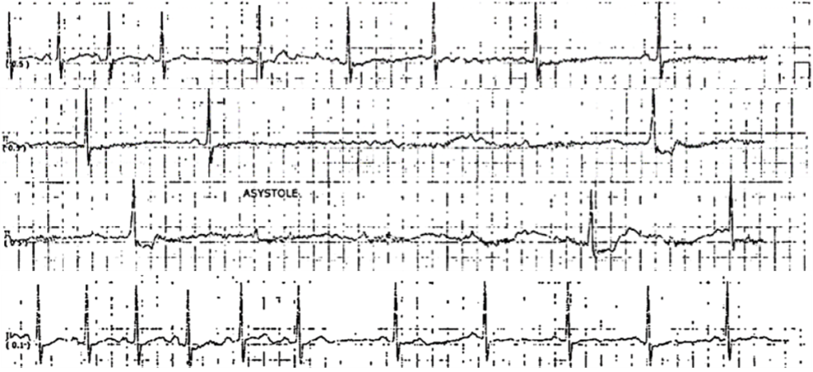
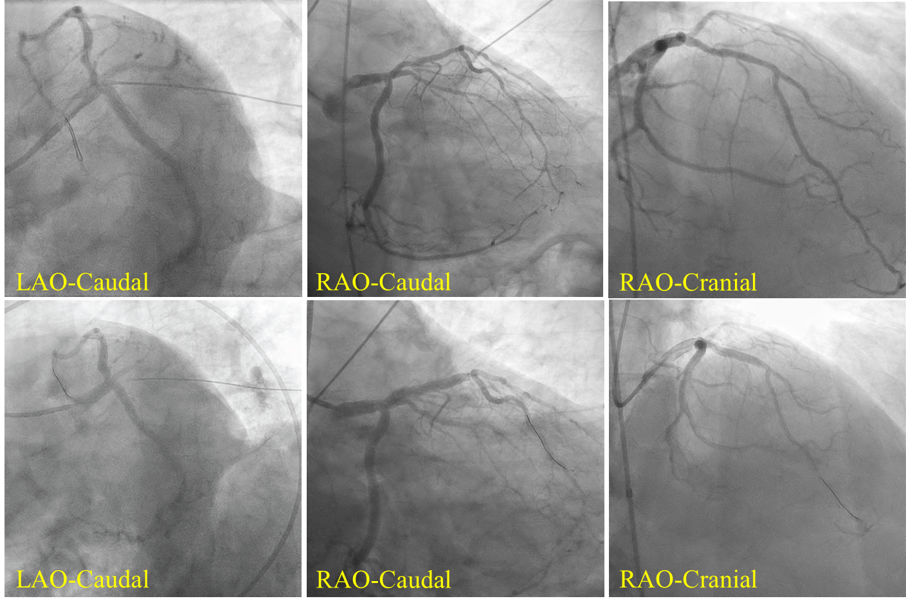
Ticagrelor’s Arresting Performance After Elective PCI
Riverside
Medical Center
Kankakee, Illinois
¹smuralidhara@rhc.net
Suchitra Muralidharan¹, MD; Andrew Mariano, DO; Abhimanyu Beri, MD
Tarun Jain, MD
Bradycardia surrounding percutaneous coronary intervention (PCI) can present a diagnostic dilemma and may be a consequence of ischemia, unrelated conduction abnormalities, or pharmacological agents.
Conclusion
Patients receiving ticagrelor can have a rare life-threatening bradyarrhythmia that warrants careful monitoring after initiation.
Background
a)
Case Presentation
A 66 year old male with history of coronary artery disease on metoprolol and sleep apnea had worsening anginal symptoms despite medical therapy.
Stress echocardiography demonstrated exercise induced anterior wall hypokinesis. Coronary angiography showed severe proximal LAD stenosis which was revascularized with a drug eluting stent.
Two hours after he received 180 mg of ticagrelor, patient was noted to have frequent episodes of sinus arrest with recurrent near syncope.
Emergent transvenous pacemaker (TVP) was inserted and he was transitioned to clopidogrel. Subsequent monitoring in the intensive care unit over 72 hours did not show any further bradyarrhythmias. TVP was removed and the patient was discharged home on metoprolol.
Outpatient 30-day event monitoring did not reveal any further bradyarrhythmias.
b)
(a) Pre-intervention 12-lead electrocardiogram (b) Representative telemetry strip of lead II 2 hours after administration of ticagrelor showing sinus arrest with recovery of sinus rhythm.
c)
Transient sinus arrest is a rare complication of ticagrelor administration that needs to be monitored.
Decision-Making
Even though sinus arrest occurred shortly after PCI, ticagrelor was deemed to be the culprit. It inhibits cellular uptake of adenosine, increasing its plasma concentration which can result in sinus slowing and AV node blockade.
(c) Left heart catheterization showing obstructive coronary artery disease in the proximal LAD with abnormal iFR at 0.7. IVUS guided PCI to proximal LAD was performed with 4x30 mm Onyx DES post-dilated to 4.5mm with a 15 mm non-compliant balloon.

