Slide 1



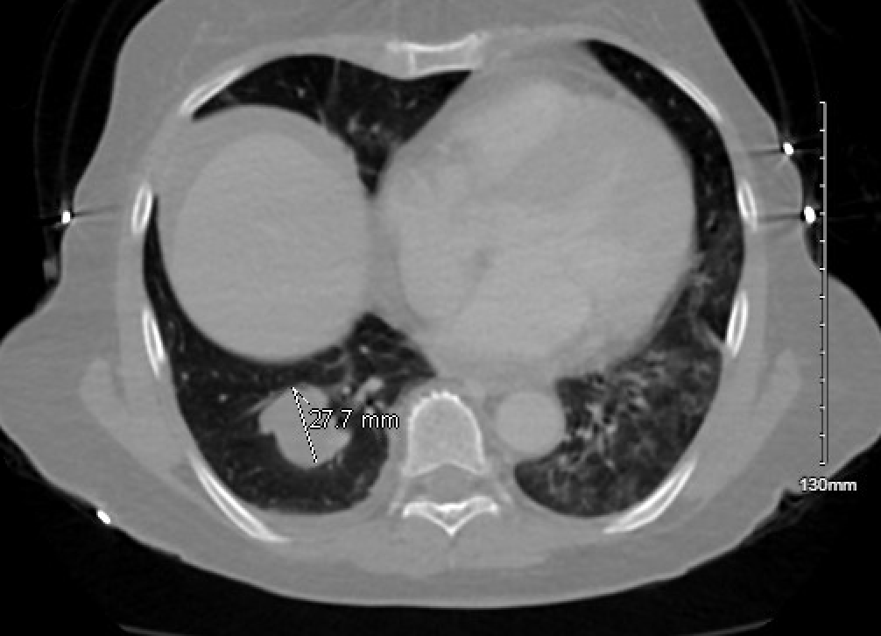
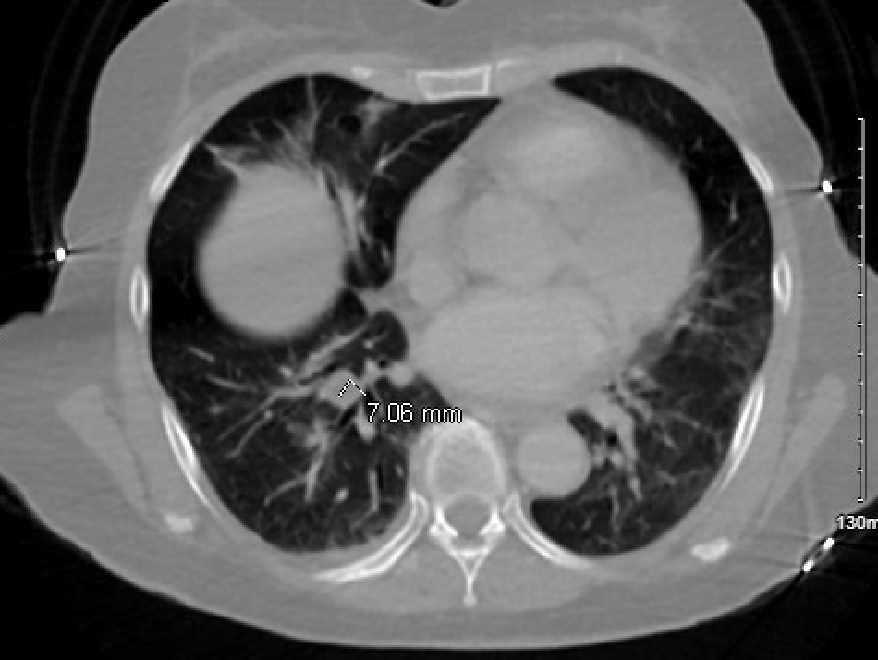
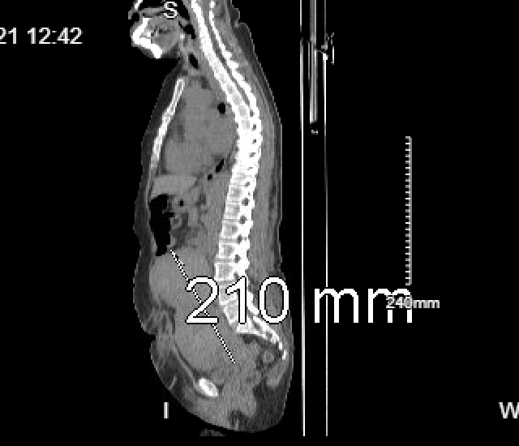
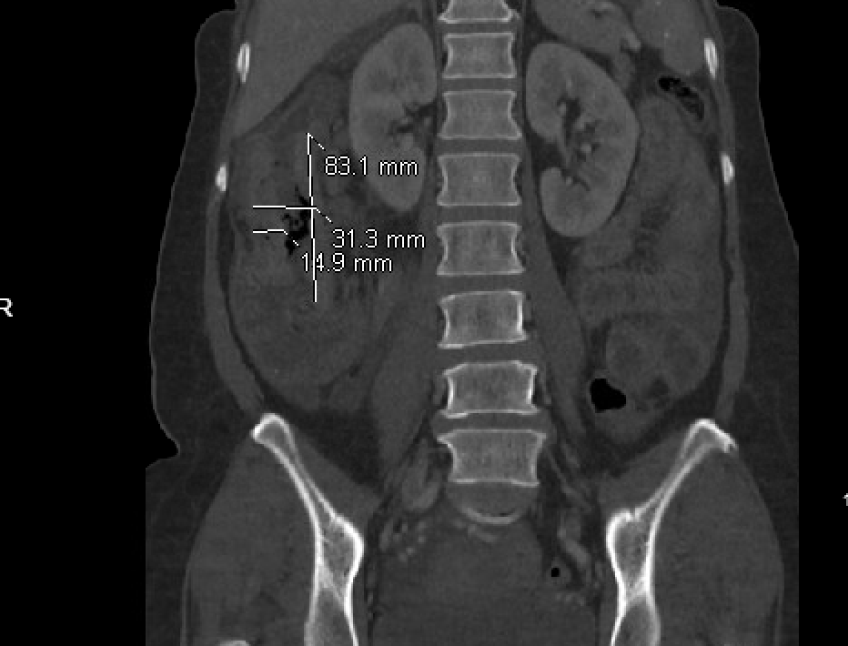
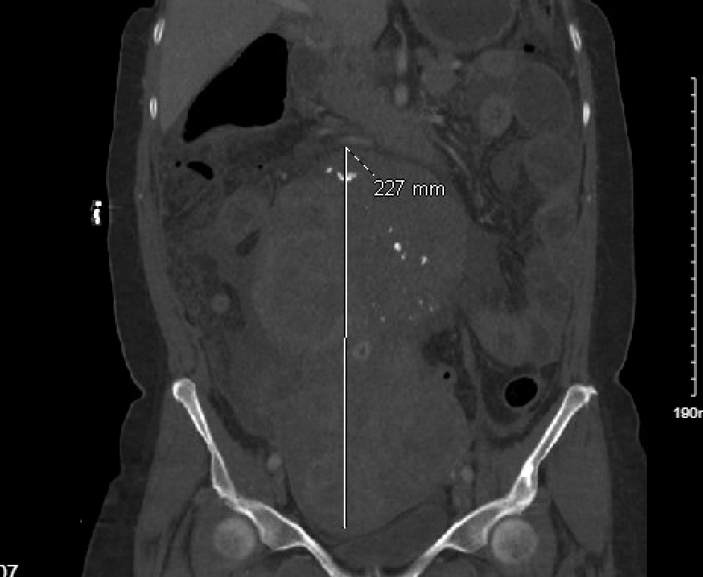
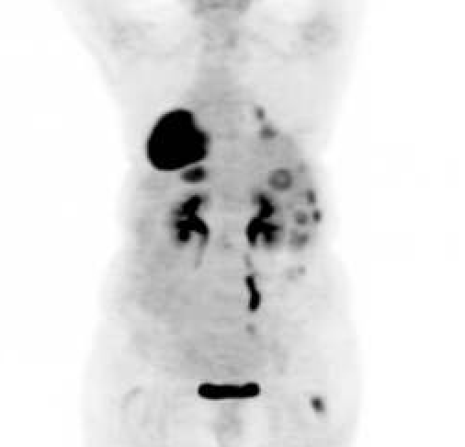
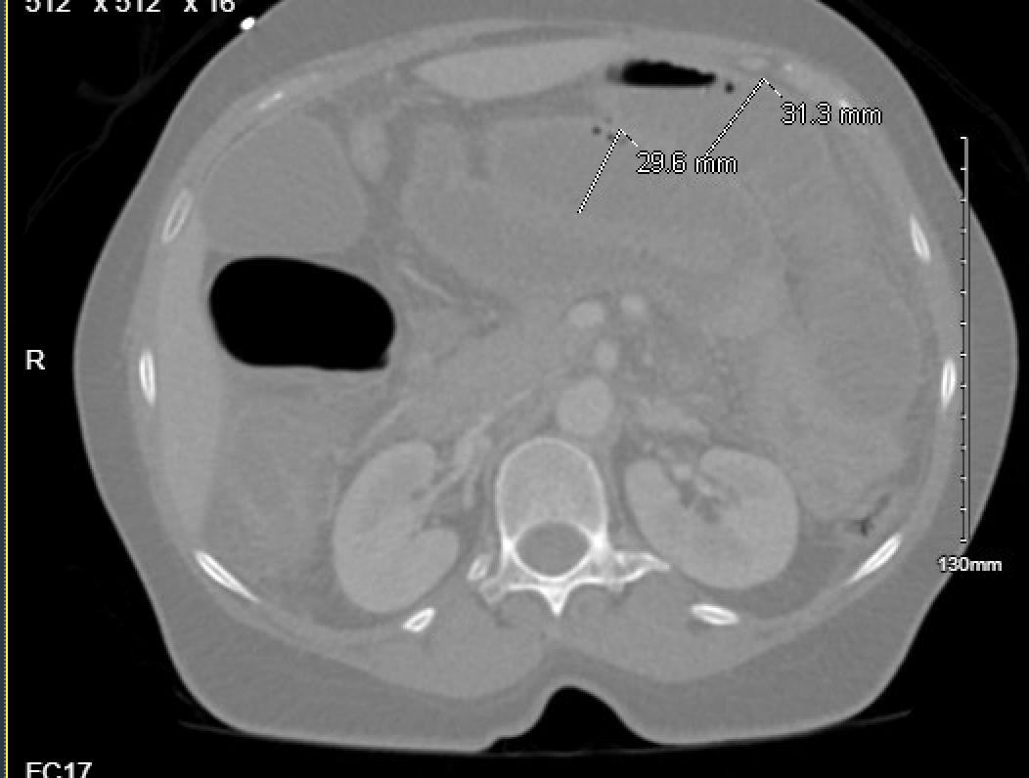
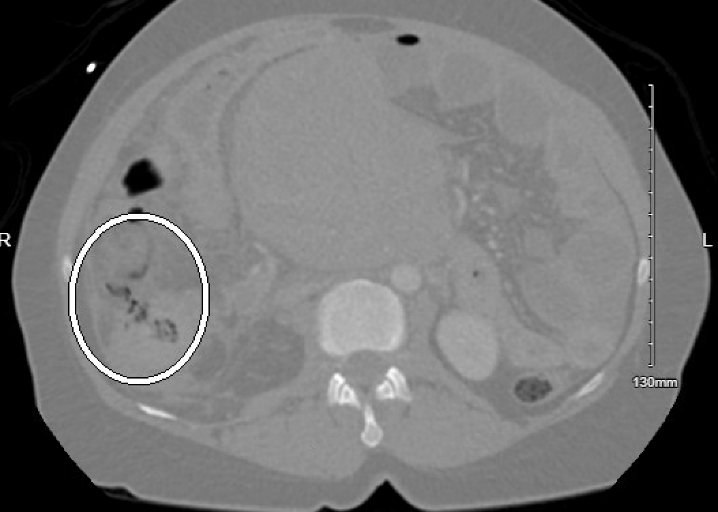
Check the colon: Colon Cancer in Clostridium septicum bacteremia
Riverside
Medical Center
Kankakee, Illinois
¹Ssingh@rhc.net
Sasha Singh¹, DO; Vijay Kata, DO; Dhruv Joshi, MD
BACKGROUND
C.septicum infection should be borne in mind in patients with an underlying malignancy and have signs of sepsis. Timely diagnosis is of the utmost importance for proper treatment.
DISCUSSION
Clostridium septicum is an anerobic gram positive forming bacillus which is commonly associated with spontaneous gas gangrene but also has associations with colonic malignancy. Though rare and uncommon diagnosis, clinicians should be aware and prompt recognition of this association may lead to improved outcomes.
Clostridium septicum bacteremia has been shown to have rates as high as 50% to 80% association with colon cancer in small studies. It is thought that disruption of the normal mucosal barrier caused by mucosal ulceration of the tumour surface and haematogenous invasion allow a portal of entry for the bacteria. Prompt treatment of Clostridium septicum bacteremia with antibiotics and source control such as bowel resection are important for a good prognosis. Clostridium septicum bacteremia remains extremely rare, however can alert physicians for underlying colorectal cancer. In addition, clinicians should be on the lookout for Clostridium septicum in patients who develop a gram positive bacteremia who have radiological findings consistent with possible colorectal malignancy.
CASE STUDY
Awareness and early diagnosis of C.septicum may improve the prognosis of what is regarded as a fatal infection.
Here we present a case of a 65 year old female found to have Clostridium Septicum bacteremia associated with colon adenocarcinoma.
The patient presented with intense lower right abdominal pain with associated vomiting that began two weeks prior to presentation. Subsequent imaging in the the emergency department with CT scan showing perforation noted along the mid portion of the ascending colon associated with a large mass that appeared to involve the distal cecum and ascending colon. Patient was started on empiric piperacillin/ tazobactam. Patient subsequently underwent emergent exploratory laparotomy and pathology from the right hemicolectomy showed adenocarcinoma the colon. Initial blood cultures obtained later grew clostridium septicum, a gram variable bacilli. Antibiotics were later adjusted according to susceptibilities. A PET scan was performed upon discharge showing progression of metastatic disease with enlarging hepatic lesions and a right lower lobe lung nodule.
FIGURE 2
Figure 2- PET scan consistent with progression of disease since CT findings.There are new and enlarging hepatic lesions, as well as enlargement of the right lower lobe mass consistent with progression of metastatic disease. Within the operative bed of the right upper quadrant there is a 2 x 3 cm area of soft tissue with metabolic activity suggesting local recurrence or residual disease versus peritoneal metastatic disease.
FIGURE 3
Figure 3- Maximum intensity Projection allowing 3-D visualization for further evaluate cancer burden as well as further evaluation of patient’s metastatic disease, particularly with new pulmonary nodules
FIGURE 1
CT Abdomen Pelvis with contrast: Axial view Top right and Top left- At least 2 presumed necrotic right pulmonary nodules are concerning for metastatic disease given the colonic findings. Coronal View Bottom right and Bottom left redemonstrating acute perforation as well as upstream dilation of the small bowel which may reflect ileus or developing bowel obstruction. There is also reactive ascites and inflammation throughout the abdominal mesentery.
Disclosures-Authors had no Disclosures
REFERENCES
1) Panikkath, Ragesh & Konala, Venu Madhav & Panikkath, Deepa & Umyarova, Elvira & Hardwicke, Fred. (2014). Fatal Clostridium Septicum Infection in a Patient with a Hematological Malignancy. Proceedings (Baylor University. Medical Center). 27. 111-2. 10.1080/08998280.2014.11929074.
2) Chew, Simon & Lubowski, David. (2001). Clostridium septicum and malignancy. ANZ Journal of Surgery. 71. 647 - 649. 10.1046/j.1445-1433.2001.02231.x.
3) Nanjappa S, Shah S, Pabbathi S. Clostridium septicum Gas Gangrene in Colon Cancer: Importance of Early Diagnosis. Case Rep Infect Dis. 2015;2015:694247. doi: 10.1155/2015/694247. Epub 2015 Dec 17. PMID: 26793397; PMCID: PMC4697071.
Figure 1- CT abdomen pelvis with contrast in axial view demonstrating acute perforation of the cecum and ascending colon. Imaging findings are highly concerning for a right colonic malignancy as the cause of perforation.

