Slide 1


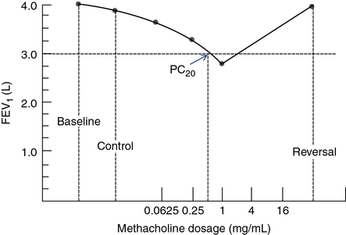
Bronchoprovocation Test Gone Awry
Riverside
Medical Center
Kankakee, Illinois
¹tandrews@rhc.net
Trisha Andrews, MD¹; Brett Ploussard, DO; Suchitra Muralidharan MD; Raju Abraham, MD
Introduction:
Methacholine, a derivative of acetylcholine, is a non-selective muscarinic receptor agonist, used for the “Methacholine Challenge Test” or “Bronchoprovocation Test” to aid in diagnosis of asthma. Serial increasing doses are administered and response is measured using spirometry. The dose at which the FEV1 decreases by greater than 20% is known as the provocative dose, “PD-FEV1”. In patients with asthma, the PD-20 FEV1 is 200. Symptoms of bronchoconstriction are easily reversed with inhaled albuterol. Documented adverse effects of methacholine apart from bronchoconstriction include pruritus, dizziness and headache. We present a case of methacholine induced anaphylaxis, which has hitherto been undocumented in the literature.
Patient was monitored overnight in the Intensive Care Unit with Continuous Positive Airway Pressure (CPAP). She gradually returned back to normal over a span of multiple days after the incident.
References
1. Mendez-Enriquez E, Alvarado-Vazquez PA, Abma W, Simonson OE, Rodin S, Feyerabend TB, Rodewald HR, Malinovschi A, Janson C, Adner M, Hallgren J. Mast cell-derived serotonin enhances methacholine-induced airway hyperresponsiveness in house dust mite-induced experimental asthma. Allergy. 2021 Jul;76(7):2057-2069. doi: 10.1111/all.14748. Epub 2021 Mar 9. PMID: 33486786.
2.Moore BJ, King GG, D'Yachkova Y, Ahmad HR, Paré PD. Mechanism of methacholine dose-response plateaus in normal subjects. Am J Respir Crit Care Med. 1998 Aug;158(2):666-9. doi: 10.1164/ajrccm.158.2.9709048. PMID: 9700148.
3. Miyata Y, Ohta S, Tanaka A, Kashima A, Suganuma H, Uno T, Sato H, Ida H, Kimura T, Jinno M, Hirai K, Homma T, Yamamoto M, Watanabe Y, Suzuki S, Sagara H. The Effect of Bronchoconstriction by Methacholine Inhalation in a Murine Model of Asthma. Int Arch Allergy Immunol. 2020;181(12):897-907. doi: 10.1159/000509606. Epub 2020 Aug 13. PMID: 32791506.
Case Description
A 57-year-old Caucasian female with history of obstructive sleep apnea, and post COVID chronic dyspnea underwent Bronchoprovocation test to evaluate for reactive airway disease. Minutes after administration of methacholine, patient experienced significant shortness of breath, hoarseness, throat constriction with hypotension and syncope. She was treated in the emergency department for anaphylaxis with intramuscular epinephrine and discharged on steroids and antihistamine. Two hours later, her symptoms recurred and she self-administered epinephrine with an Epi pen which she had been sent home with. She returned to the emergency department in acute respiratory distress with decreased air movement bilaterally, significant wheezing and hoarseness. She was again treated with two doses of IM epinephrine, diphenhydramine and steroids.
Discussion
Certain medications such as antibiotics and analgesics are often implicated in medication induced anaphylaxis. There have been no reported cases of Methacholine Induced Anaphylaxis. Fortunately, methacholine exposure only occurs in controlled healthcare environments. Methacholine anaphylaxis is currently an unknown entity but can physiologically be explained by its broncho-constrictive properties. Although this may have been an isolated incident, it is important to create awareness that even benign medications that are commonly used can cause serious adverse events in certain populations.

