Slide 1


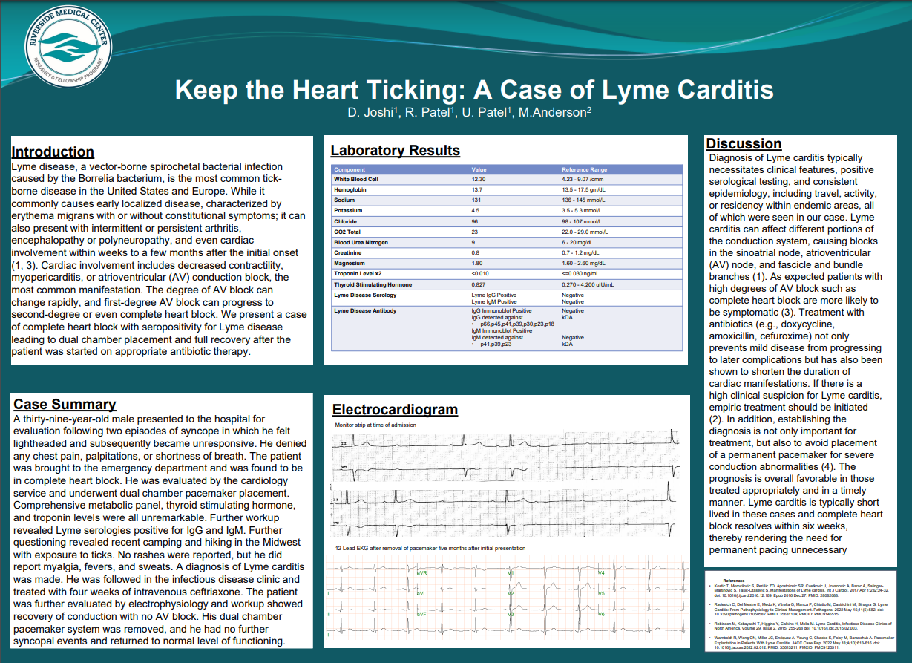
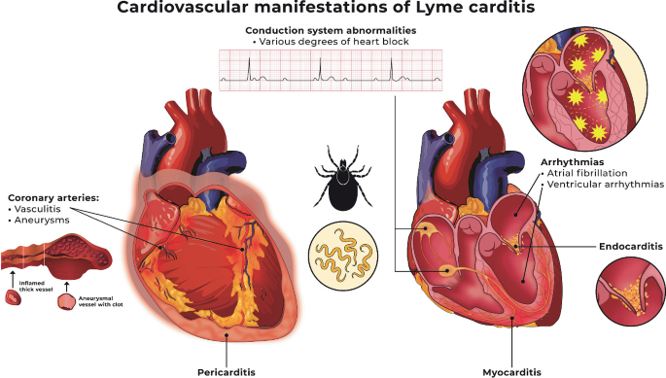

Keep the Heart Ticking: A Case of Lyme Carditis
Riverside
Medical Center
Kankakee, Illinois
¹nvattem@rhc.net
Nishita Vattem D.O.¹, Rahul Patel D.O., Sasha Singh D.O., Michael Anderson M.D., Nha Huynh D.O., Dhruv Joshi D.O.
BACKGROUND
DISCUSSION
Lyme disease, a vector-borne spirochetal bacterial infection caused by the Borrelia bacterium, is the most common tick-borne disease in the United States and Europe. While it commonly causes early localized disease, characterized by fever and erythema migrans with or without other constitutional symptoms, it can also present with intermittent or persistent arthritis, encephalopathy or polyneuropathy, and even cardiac involvement within weeks to a few months after the initial onset. Cardiac involvement ranges from myopericarditis to atrioventricular (AV) conduction block, the most common manifestation. The degree of AV block can change rapidly, for example a first-degree AV block can progress to second-degree or even complete heart block. We present a rare case of complete heart block with seropositivity for Lyme disease leading to dual chamber placement and full recovery after the patient was started on appropriate antibiotic therapy.
Cardiac involvement of Lyme disease can range from asymptomatic to self-limited symptoms and to varying degrees of atrioventricular block
Prognosis of Lyme carditis is favorable among treated patients with AV block usually short-lived with management of a temporary pacemaker
Lyme carditis can affect different portions of the conduction system, causing blocks in the sinoatrial node, atrioventricular (AV) node, and fascicle and bundle branches. As expected, and as seen in our case, patients with high degrees of AV block such as complete heart block are more likely to be symptomatic. Treatment with antibiotics (e.g. doxycycline, amoxicillin, cefuroxime) not only prevents mild disease from progressing to worse complications but has also been shown to shorten the duration of cardiac manifestations. If there is a high clinical suspicion for Lyme carditis, empiric treatment should be initiated immediately.
In addition, establishing the diagnosis is not only important for choice of treatment, but also to avoid unnecessary placement of a permanent pacemaker for severe conduction abnormalities. Prognosis is favorable among appropriately treated patients and Lyme carditis is relatively short lived as complete heart block typically resolves within six weeks.
INVESTIGATION
FIGURE 2
A 39-year-old male presented to the hospital for evaluation following two episodes of syncope, in which he felt lightheaded and subsequently became unresponsive. He denied any chest pain, palpitations, or shortness of breath. The patient was brought to the emergency department and was found to be in complete heart block (figure 3). He was evaluated by cardiology and underwent dual chamber pacemaker placement. Comprehensive metabolic panel, thyroid stimulating hormone, and troponin levels were all unremarkable. Further workup revealed Lyme serologies positive for IgG and IgM (figure 2). Further questioning revealed recent camping and hiking in the Midwest with exposure to ticks. No rashes were reported, but he did report myalgia, fevers, and sweats.
MANAGEMENT
A diagnosis of Lyme carditis was made. He was followed in the infectious disease clinic and treated with four weeks of intravenous ceftriaxone. The patient was further evaluated by electrophysiology and workup showed complete recovery of conduction with no AV block. His dual chamber system was subsequently removed, and he had no further episodes of syncopal events and returned to normal level of functioning.
FIGURE 3
REFERENCES
Wang, C., Chacko, S., Abdollah, H., & Baranchuk, A. (2019). Treating Lyme carditis high-degree AV block using a temporary-permanent pacemaker. Annals of noninvasive electrocardiology : the official journal of the International Society for Holter and Noninvasive Electrocardiology, Inc, 24(3), e12599. https://doi.org/10.1111/anec.12599
Kostić, T., Momčilović, S., Perišić, Z. D., Apostolović, S. R., Cvetković, J., Jovanović, A., Barać, A., Šalinger-Martinović, S., & Tasić-Otašević, S. (2017). Manifestations of Lyme carditis. International journal of cardiology, 232, 24–32. https://doi.org/10.1016/j.ijcard.2016.12.169
Radesich, C., Del Mestre, E., Medo, K., Vitrella, G., Manca, P., Chiatto, M., Castrichini, M., & Sinagra, G. (2022). Lyme Carditis: From Pathophysiology to Clinical Management. Pathogens (Basel, Switzerland), 11(5), 582. https://doi.org/10.3390/pathogens11050582
Wamboldt, R., Wang, C. N., Miller, J. C., Enriquez, A., Yeung, C., Chacko, S., Foisy, M., & Baranchuk, A. (2022). Pacemaker Explantation in Patients With Lyme Carditis. JACC. Case reports, 4(10), 613–616. https://doi.org/10.1016/j.jaccas.2022.02.012
Figure 1 – cardiac involvement of Lyme disease ranges from decreased contractility and myopericarditis to arrhythmias including atrioventricular (AV) conduction block
The authors have no disclosures.

