Slide 1


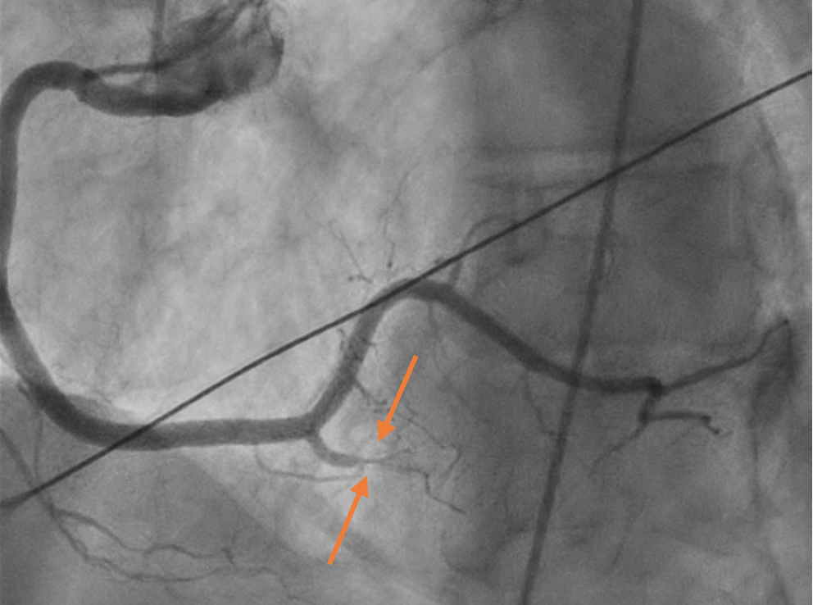
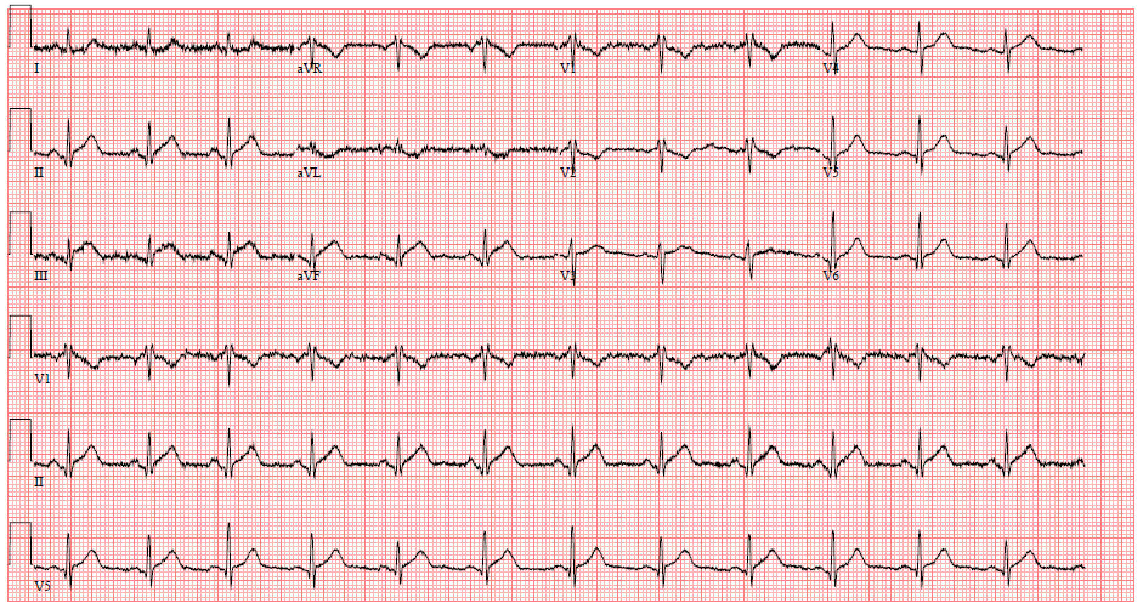
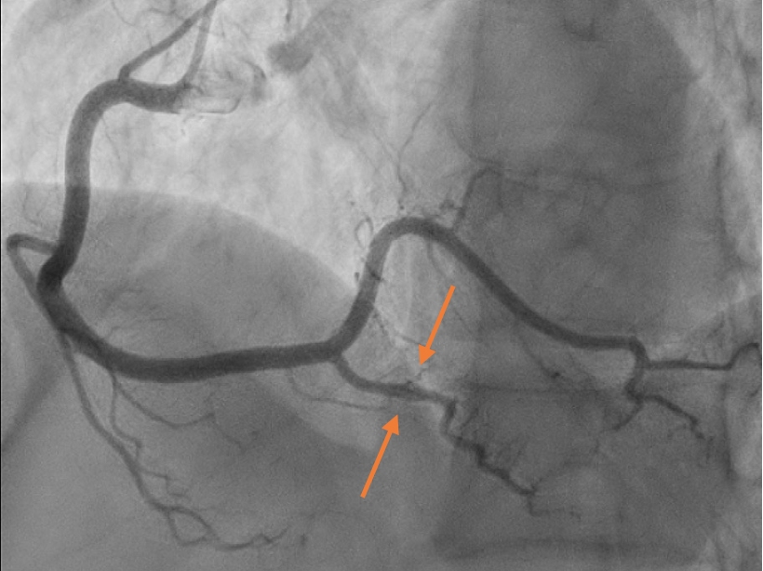

Repeat Offender: Spontaneous Coronary
Artery Dissection
Riverside
Medical Center
Kankakee, Illinois
¹nvattem@rhc.net
Nishita Vattem D.O.¹, Vijay Kata M.D., Dureshahwar Ali D.O., Dhruv Joshi D.O., Nathan Frogge M.D
BACKGROUND
DISCUSSION
Acute coronary syndrome is a range of conditions that are caused by decreased or complete loss of blood flow to regions of the heart wall. There is a wide set of etiologies with different treatment guidelines and therefore, it is important to diagnose accurately to prevent repeat offenses and improve overall morbidity and mortality of the patient population. For instances of spontaneous coronary artery dissection, goal directed medical therapy consists of a beta blocker and hypertension control.
Spontaneous coronary artery dissection is one of the causes of acute coronary syndrome that requires immediate attention.
Current goal directed medical therapy after consists of a beta blocker and control of hypertension.
This case emphasizes a need for further risk stratifications such as smoking cessation predict the recurrence of SCAD and essentially decrease morbidity and mortality.
SCAD is a significant cause of acute coronary syndrome with patients presenting with acute chest pain. SCAD has a high rate of recurrence of 29% within 2-3 years and 11% within 10 years. Recurrent SCAD typically occurs in a different anatomical site than the initial occurrence and can present itself as a myocardial infarction, ventricular arrhythmia, or cardiogenic shock. Current research indicates that medical management with a beta blocker and controlling hypertension should decrease the risk of recurrence of SCAD. Studies also show that increased tortuosity of the coronary arteries increase risk of recurrence. However, this patient was taking a beta blocker, had controlled hypertension, and no tortuosity of her coronary arteries seen on angiograms. There is also an unclear association between smoking and recurrence of SCAD based on current literature review.
INVESTIGATION
We have a 63-year-old female with a history of spontaneous coronary artery dissection (SCAD) of the left anterior descending artery (LAD) 2 years prior that was found on a left heart catheterization after she presented to the ER with a complaint of chest pain with associated dyspnea. On a physical exam, the patient was in distress with an unremarkable cardiopulmonary exam. EKG was significant for ST elevations in leads II, III, and aVF consistent with an inferior STEMI (figure 1).
FIGURE 2
Figure 2 – TIMI 1 flow through the RPDA indicating total vessel occlusion leading to inferior STEMI
MANAGEMENT
She was urgently taken for coronary angiography that showed severe (90%) stenosis of the long segment branch of the right posterior descending artery (RPDA) with pruning of distal branches consistent with SCAD. Initially, the artery had TIMI 1 flow (figure 2) but improved to TIMI 2 flow with intracoronary nitroglycerin administration (figure 3). No increased tortuosity was noted on the angiogram. Echocardiogram done showed an ejection fraction of 60-65%. Her risk factors for metabolic syndrome were optimized. She was monitored closely in the ICU overnight on nitroglycerin infusion with management of chest pain. She was counseled on the benefits of tobacco smoking cessation and the risks of possible SCAD recurring with continued smoking.
FIGURE 3
Figure 3 – TIMI 2 flow through RPDA after intracoronary nitroglycerin administration with resolution of previous occlusion
CONCLUSSION
This case is reported to emphasize a need for further risk stratifications to predict the recurrence of SCAD. Particularly, into the association with smoking seeing that our patient was on goal directed medical therapy yet still suffered from SCAD recurrence. Data is clear in optimizing goal directed medical therapy early on in treating the manifestations of metabolic syndrome including hypertension, diabetes, and heart disease which leads to less hospitalizations. Recurrent SCAD truly is a phenomenon for which medical therapy still may not prevent acute coronary events.
REFERENCES
Kok, S. N., & Tweet, M. S. (2021). Recurrent spontaneous coronary artery dissection. Expert review of cardiovascular therapy, 19(3), 201–210. https://doi.org/10.1080/14779072.2021.1877538
Rosengarten, J. A., & Dana, A. (2012). Recurrent spontaneous coronary artery dissection: acute management and literature review. European heart journal. Acute cardiovascular care, 1(1), 53–56. https://doi.org/10.1177/2048872612442404
Echeverry, T., Mehan, S., & Williams, K. (2021). Abstract 10411: Recurrent Spontaneous Coronary Artery Dissection. Circulation, 144(Suppl_1). https://doi.org/10.1161/circ.144.suppl_1.10411
Saw, J, Humphries, K, Aymong, E. et al. Spontaneous Coronary Artery Dissection: Clinical Outcomes and Risk of Recurrence. J Am Coll Cardiol. 2017 Aug, 70 (9) 1148–1158. https://doi.org/10.1016/j.jacc.2017.06.053
Xu, Minmin; Wang, Jian; Yuan, Kangzheng; Luo, Xiaoyan; Liu, Fangmeic; Deng, Minc; Wang, Daxind. Recurrent spontaneous coronary artery dissection. Coronary Artery Disease 34(1):p 59-65, January 2023. | DOI: 10.1097/MCA.0000000000001199
Figure 1 – Presenting EKG with ST elevations in leads II, III, and aVF consistent with inferior STEMI
DISCLOSURE INFORMATION
The authors have no disclosures.

