Slide 1


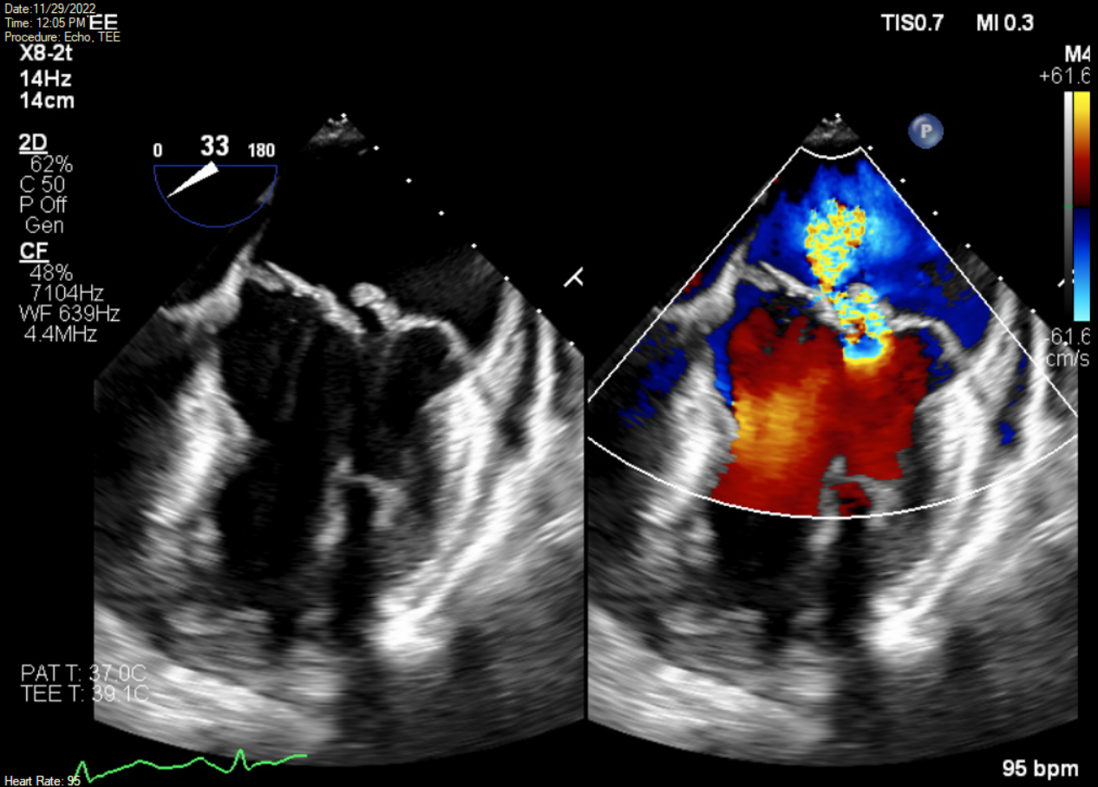
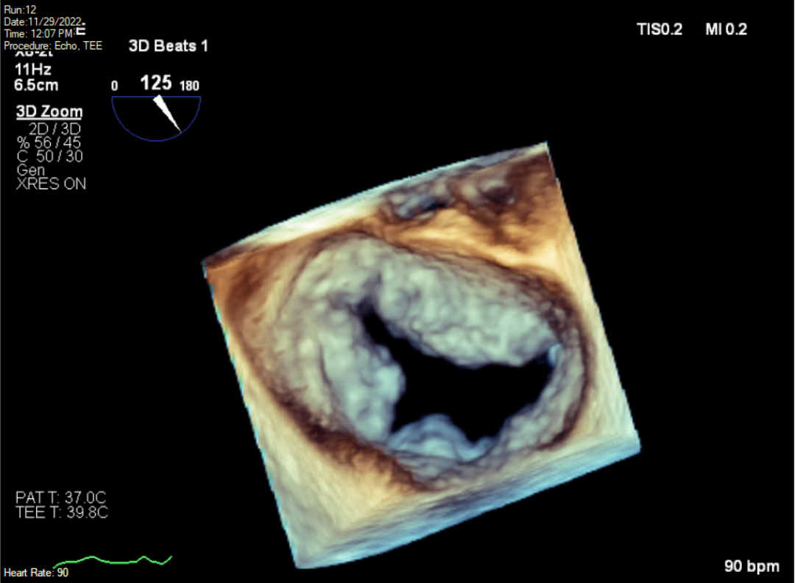
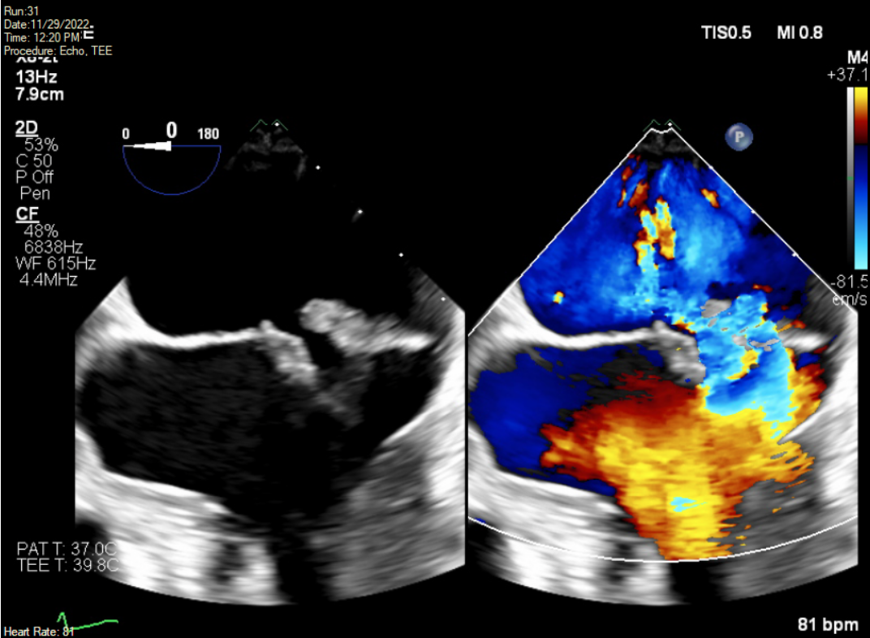
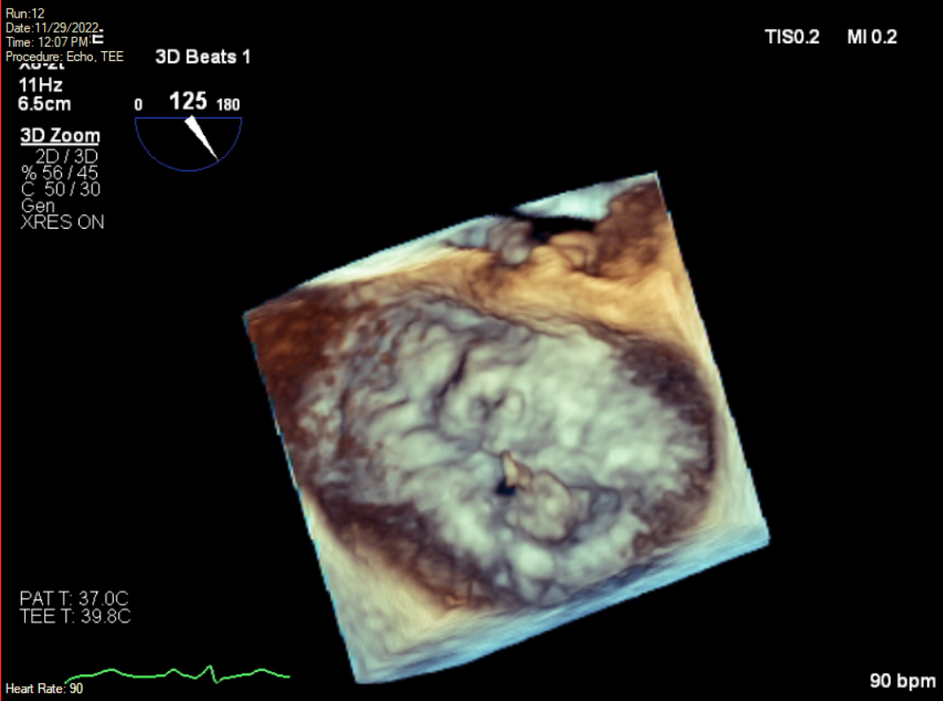

The Uninvited Weight Loss Coach: A Case of Enterococcus Durans Endocarditis
Riverside
Medical Center
Kankakee, Illinois
¹nvattem@rhc.net
Nishita Vattem D.O.¹, Rahul Patel D.O., Dhruv Joshi D.O., Irfan Vora D.O., Andrew Mariano D.O., Nathan Frogge M.D, Michael Anderson M.D., Nadeem Ansari M.D.
BACKGROUND
Enterococcus durans is a rare cause of infective endocarditis requiring prompt diagnosis, appropriate antimicrobial therapy, and timely surgical intervention.
DISCUSSION
Enterococcus durans is a gram-positive coccus and is a rare cause of endocarditis, with only four prior cases reported. Like other enterococci, E.durans is part of the normal gut microbiota, however can lead to urinary tract infections, intra-abdominal infections, and uncommonly bacteremia and endocarditis. E.durans is inherently resistant to several classes of antibiotics including macrolides and clindamycin. We present a rare case of E. durans endocarditis and highlight the importance of early recognition and prompt management of this uncommon but potentially devastating infection.
The diagnosis of Enterococcus durans endocarditis can be challenging due to its rarity and similarities with other Enterococcus species. In this case, the patient presented with nonspecific symptoms, including weight loss and fatigue, which made the initial diagnosis difficult. Given the intrinsic antibiotic resistance of Enterococcus durans, appropriate antimicrobial therapy is crucial for successful treatment. In this case, the patient was initially started on intravenous vancomycin and ampicillin-sulbactam, but subsequent susceptibility testing showed resistance to both antibiotics. Therefore, the patient's antimicrobial therapy was changed to ampicillin and ceftriaxone, to which Enterococcus durans was found to be susceptible.
Surgical intervention, such as valve replacement, is often necessary in cases of enterococcal endocarditis, especially if there are complications such as valve dysfunction or heart failure. In this case, the patient underwent valve replacement surgery, which was successful in resolving the infection. Although Enterococcus durans endocarditis is a rare infection, it is important for clinicians to be aware of its clinical presentation and management, especially given its intrinsic antibiotic resistance.
INVESTIGATION
A 65-year-old male presented to the primary care office with three months of unintentional weight loss of 30 lbs, nonproductive cough, night sweats, and generalized fatigue. On physical exam, he was noted to have a holosystolic murmur. The patient underwent extensive outpatient testing, including a CT of his chest and abdomen, which was notable for a right renal calculus and an incidentaloma of the pancreas. He also had normal pulmonary function testing. An echocardiogram revealed a myxomatous mitral valve with bileaflet mitral valve prolapse and partial flail of posterior mitral leaflet, leading to moderate to severe eccentric mitral regurgitation. He also had CRP notably elevated to 72, ferritin 785, and ESR 46. Blood cultures were obtained notable for Enterococcus durans. Subsequently, the patient was admitted to the hospital and initially treated with vancomycin and ampicillin-sulbactam.
FIGURE 2
Figure 2: 3D mitral valve from the atrial aspect (“surgeon’s view) in diastole.
MANAGEMENT
Further evaluation with transesophageal echocardiogram showed mitral valve posterior leaflet thickening and prolapse with a mobile 1x1 cm vegetation attached to P2 leaflet with associated anterior mitral leaflet thickening with likely pannus of vegetation in addition to severe eccentric mitral regurgitation (EROA 0.5cm2, RVol 60ml). Blood cultures resulted in growth of Enterococcus durans, and antibiotics were tailored to ampicillin and ceftriaxone. Once blood cultures had cleared, the patient underwent mitral valve replacement with a 31 mm Medtronic Mosaic porcine bioprosthesis, with tissue culture of mitral valve leaflets revealing Enterococcus durans. The patient was treated with six weeks of antibiotic therapy with repeat echocardiogram revealing no paravalvular regurgitation.
FIGURE 3
REFERENCES
Figure 3: 3D mitral valve from the atrial aspect (“surgeon’s view) in systole
Vijayakrishnan, R., & Rapose, A. (2012). Fatal Enterococcus durans aortic valve endocarditis: a case report and review of the literature. BMJ case reports, 2012, bcr0220125855. https://doi.org/10.1136/bcr-02-2012-5855
Al Shehri, M., Zarak, M. S., & Sarwari, A. R. (2020). Late Prosthetic Valve Infective Endocarditis by Enterococcus durans. Journal of global infectious diseases, 12(3), 152–155. https://doi.org/10.4103/jgid.jgid_99_19
Kenzaka, T., Takamura, N., Kumabe, A. et al. A case of subacute infective endocarditis and blood access infection caused by Enterococcus durans . BMC Infect Dis 13, 594 (2013). https://doi.org/10.1186/1471-2334-13-594
Luca Fallavollita, Lorena Di Gioacchino, Fabrizio Balestrini; Bioprosthetic Aortic Valve Endocarditis in Association with Enterococcus durans. Tex Heart Inst J 1 April 2016; 43 (2): 165–167. doi: https://doi.org/10.14503/THIJ-14-4980
Figure 1 – The vegetation is seen on atrial aspect of posterior leaflet of the mitral valve. There is also thickening of the anterior leaflet suspicious for bileaflet involvement. Gross malcoaptation of mitral leaflets and severe mitral regurgitation is also seen
The authors have no disclosures.

