Slide 1


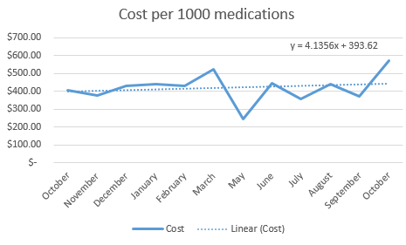
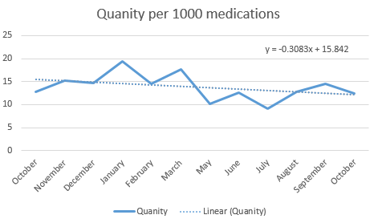
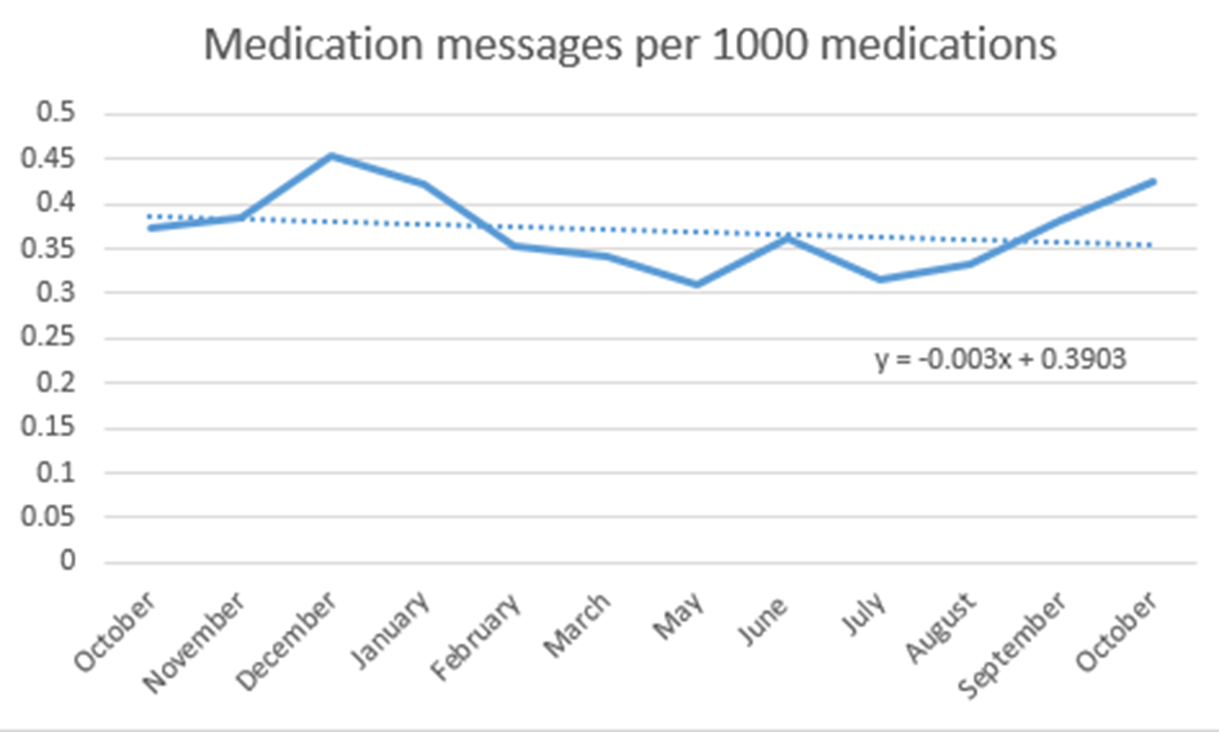
Utilization of Dispense Tracking to
Reduce Re-dispensing
Riverside
Medical Center
Kankakee, Illinois
Chad Ketelaar, PharmD., Whitney Pelletier, PharmD. BCPS.
Background
Over the last several decades, the addition of automatic dispensing cabinets and better electronic medical records has helped decrease the number of medication errors and help track medication dispenses. Technology advancements have led to better tracking software that can follow medications from the beginning of the filling process until medication administration occurs for the patient. This new software allows hospitals to reduce waste and have better control over missing doses of medications on the floors. Several studies have examined this software from larger institutional hospitals' perspective and the observed cost savings. The main areas of research that have been studied are the following:
•Reduction in the number of missing medications
•Reduction in cost of re-dispensing missing medications
•Reduction in messages/phone calls asking about missing medications from nurses
Enabling pharmacists, pharmacy technicians, and nurses to track medication at every step can alleviate the burdens caused by rising medication costs and lost productivity from redoing unnecessary work in hospitals.
Results
Analysis showed that the number of missing medications per 1000 medications dispensed decreased by approximately 25%. This was statistically significant with a p-value of 0.01.
Analysis showed the cost of missing medication per 1000 medications dispensed saw a decrease of approximately 7% after the implementation of the program. This was not seen to be statistically significant and had a p-value of 0.56.
These results were achieved by the pharmacist with a medication tracking compliance rate of approximately 80%
Training of pharmacists has helped increase compliance and has been shown to decrease the number of missing medications.
Medication tracking compliance has increased from 70% at the beginning of implementation to 85% in the month of October
Analysis of medication messages per 1000 medications showed a decrease of 8%. This was shown to be not statistically significant with a p value of 0.2.
Discussion
Addressing significant technological and behavioral barriers to achieving 90% compliance within the pharmacy department
Ongoing discussions with pharmacy staff on barriers and improvements for better utilization in workflow
Pharmacy and Nursing Education opportunities
Monthly reports will be run to assess compliance and review process improvements
Conclusion/ Next Steps
Continue Data Collection
Monthly data generated from within Epic
Trend utilization of program throughout the pharmacy
Dispense Tracking Dashboard
Establishes a standardized reporting system
Sent out monthly
Nursing Education
Continue educating nursing staff about program and ability to track medication filling process
Quick reference tool for pharmacy staff
Improvement Opportunities
Establish a place to post or submit workflow improvements for pharmacy
Meet with nursing managers to get input on process to decrease missing medications.
Improvement to current processes
Methods
Utilized reports generated within Epic to collect raw data on every medication sent from the pharmacy over the past 12 months.
Collected data pre-/post-implementation of the dispense tracking software in Epic.
Pre-implementation data was collected from October 2021 to March 2022.
Post-implementation data was collected from May 2022 to October 2022.
A washout period of 1 month in April 2022 was given for education and training
Created tables to track the cost, medication messages, and missing medications throughout the hospital.
Performed a retrospective review of all medications sent from the pharmacy in order to identify the usefulness of the dispense tracking program.
Tracked all medications that were filled and sent from the pharmacy.
References
1. Peek G, Campbell U, Kelm M. Impact of Medication Dose Tracking Technology on Nursing Practice. Hosp Pharm. 2016;51(8):646-653. doi:10.1310/hpj5108-646
2. Kelm M, Campbell U. Impact of Mobile Dose-Tracking Technology on Medication Distribution at an Academic Medical Center. Hosp Pharm. 2016;51(5):382-388. doi:10.1310/hpj5105-382
3. Gunter Z, Lawson N, Bondarenka C. Impact of Dispense Tracking Software on Inpatient Pharmacy Operations. J Pharm Technol. 2022;38(2):88-94. doi:10.1177/87551225211069001
4. Bhakta SB, Deyhim N, Zafar N, Abbasi GA. Implementation and evaluation of an EHR-integrated mobile dispense tracking technology in a large academic tertiary hospital. Am J Health Syst Pharm. 2022;79(18):1562-1569. doi:10.1093/ajhp/zxac154

