Slide 1


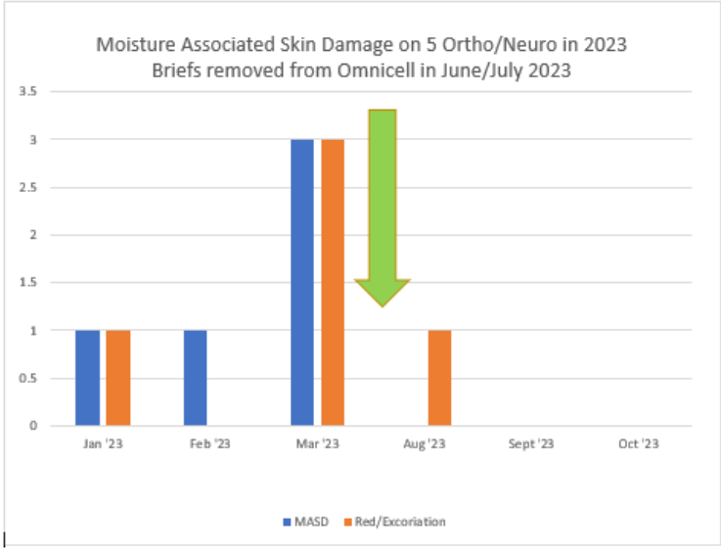
Brief-Free: An Initiative to Prevent Moisture Associated Skin Damage
Riverside
Medical Center
Kankakee, Illinois
mmccormick@rhc.net
M. McCormick, BSN, RN, S. Culver BSN, RN, Med-Surg.-BC , S. Carter, BSN,
J. Bailey, CNA, D. McDevitt, CNA
M. Ondrey, MSN, APRN/CNS, OCN, Geron.-BC
BACKGROUND
Moisture-associated skin damage (MASD) is superficial damage to the skin due to prolonged exposure to moisture such as urine or stool. The use of incontinence garments such as pull-ups and diapers can create an environment that increases the risk of developing MASD due to incontinence. The Ortho/Neuro Unit Based Council (UBC), developed a protocol with the aim of managing moisture related to urine and stool, known risks in the development of HAPIs. The goal was to decrease MASD by reducing the use of diapers and pull-ups and implementing absorbent incontinence pads to manage incontinence.
Brief-Free Protocol
Discussion/Results
Post-intervention, the unit data reflected a reduction in the occurrence of moisture-associated skin damage. These results support the use of absorbent incontinence pads over briefs and diapers in the management of urinary and fecal incontinence
Conclusion
Post-intervention, the unit data reflected a reduction in the occurrence of MASD. These results support the use of absorbent incontinence pads over briefs and diapers in the management of urinary and fecal incontinence. These results suggest the practice of using absorbent incontinence pads over diapers and pull-ups should be disseminated across all acute care units.
Continent of bowel & bladder | No absorbent pad; No Brief/Diaper; No External Urinary Catheter
Incontinent and Assist to Chair/Commode | Absorbent pad; Briefs available if ambulate in hall or pt/family request; No external urinary catheter
Incontinent and complete care (primarily in bed) | Absorbent pad; No Brief/Diaper; May add External catheter if meet criteria per policy
All patients with incontinence at time of discharge | Brief/Diaper for transport
Methods
Through a review of literature supporting evidence was found regarding the occurrence of MASD and the use of diapers and briefs. Based on the findings, the UBC developed a protocol aimed at reducing the use of diapers and briefs and implementing the use of absorbent pads for patients with incontinence. The UBC then educated the staff on the protocol in June 2023. In July, the protocol was trialed. PDCA was conducted based on feedback from staff and patients and the protocol was revised based on the feedback. Data collection occurred from August 2023-October 2023,through prevalence studies.
References:
1 Am J Crit Care. 2020 November 01; 29(6): e128–e134. doi:10.4037/ajcc2020810.
2. Elimination of the Use of Adult Briefs and Pull-Ups to Reduce Hospital Acquired Pressure Injuries (HAPIs’). Geangina Day, RN, BSN, CWON, Lehigh Valley- Pocono, East Stroudsburg,

