Slide 1

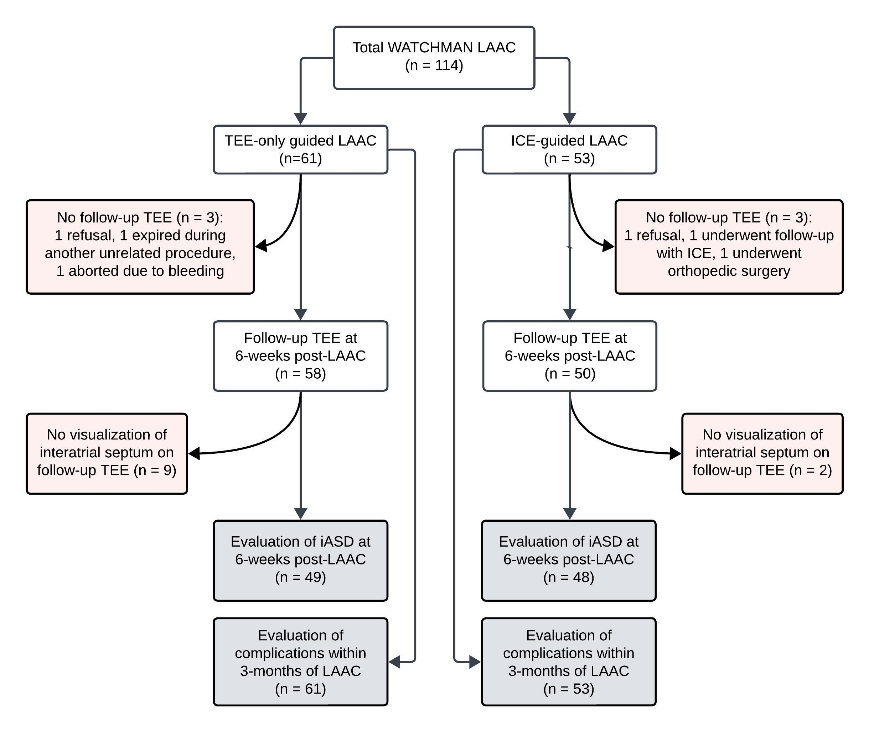
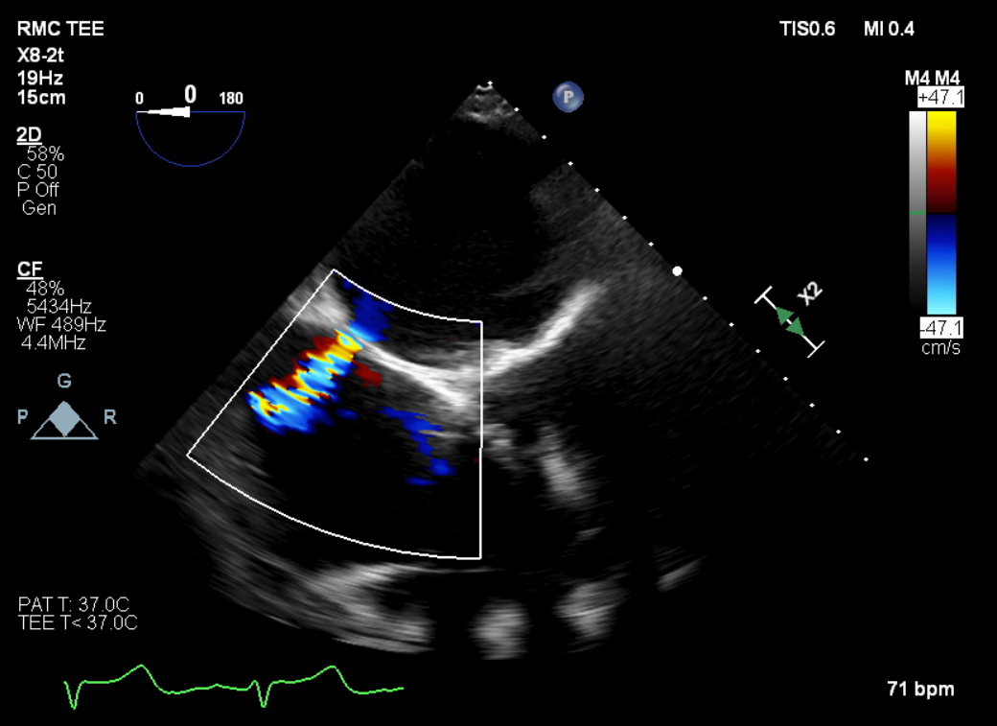
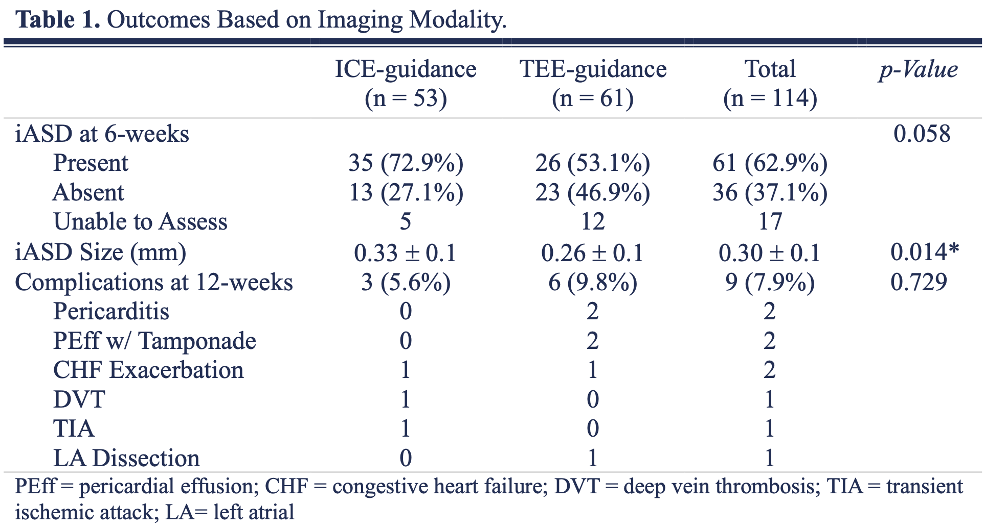
Iatrogenic Atrial Septal Defects Following Intracardiac Echocardiography Guided Left Atrial Appendage Occlusion
Iga Fudyma, MS4¹; Vikas Kiran Patel, MD; Tiffany Furlan, BSN; John Adams, PhD; Abhimanyu Beri, MD
Riverside Medical Center
Kankakee, Illinois
¹ ifudyma36@midwestern.edu
Background
Iatrogenic atrial septal defects (iASDs) are an inevitable consequence of percutaneous left atrial appendage closure (LAAC). Data regarding persistence and clinical significance of iASDs following intracardiac echocardiography (ICE)-guided LAAC is scant.
Methods
This was a single-center retrospective study. All patients who underwent WATCHMAN LAAC at our institution (1/20-7/23) were enrolled and stratified into 2 groups, ICE- or transesophageal (TEE)-guided LAAC. Persistence of iASD at 6-weeks post-LAAC was assessed using TEE with color flow Doppler and shunt size measurement. Adverse events (e.g., cardiac-related hospitalizations, thromboembolic events) within 12-weeks post-LAAC were analyzed.
Figure 2. Transesophageal echocardiography with color flow Doppler at 6-weeks post-LAAC demonstrating an interatrial shunt.
Figure 1. Flow diagram of patient selection and study design.
Conclusion
Our findings highlight that iASDs are a prevalent outcome of LAAC procedures, particularly with the utilization of ICE-guidance. In light of the recent FDA approval of ICE-only guidance for LAAC, further investigation employing a larger sample size and an extended follow-up period are imperative to thoroughly evaluate the long-term safety and efficacy of this approach.
Results
At 6-weeks persistence of iASDs was marginally significant with an incidence of 72.9% in ICE- and 53.1% in TEE-guided group (OR=2.26, p=0.058; φ=0.21). ICE-guidance was associated with significantly larger defects (0.22 ± 0.1mm vs 0.26 ± 0.1mm, p=0.014). However, adverse events were comparable among both groups (p=0.729).
Disclosure
The authors have no disclosures.

