Slide 1

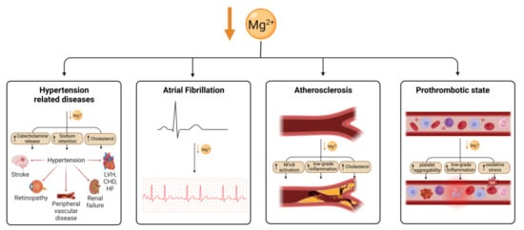
HEART FAILURE BMP
A Quality Improvement Project to Improve Care of Admitted Heart Failure Patients
Trisha Andrews, MD; Suchitra Muralidharan, MD; Tarun Jain, MD; Thomas Betlej, MD
BACKGROUND/AIM
CONCLUSION
Decreased magnesium is associated with increased cardiovascular mortality. Magnesium repletion is necessary before potassium repletion, lack of which, plays an important role in development of cardiac arrhythmia. Low magnesium has also been implicated in sudden death, notably in patients with congestive heart failure. The Riverside Medical Center (RMC) Internal Medicine residents and cardiology team noticed that there was a significant delay in magnesium repletion among patients admitted with heart failure. We aimed to reduce this delay in Magnesium check in these patients.
EFFECTS OF MAGNESIUM DEFICIENCY ON CARDIOMETABOLIC PROCESS
Ordering a “Heart Failure BMP” in patients admitted with heart failure was able to reduce the delay associated with ordering BMP / CMP alone which in turn allows for early electrolyte repletion.
In the future, we aim to demonstrate downstream effects this may have on improving patient safety and reducing length of stay.
INTERVENTION
The current treatment goal for these patients is to maintain potassium levels > 4 mmol/L and magnesium levels of > 2 mg/dL. Daily morning labs included a Complete Metabolic Panel (CMP) or Basal Metabolic Panel (BMP). These tests did not contain a magnesium level. The process for ordering a follow-up magnesium was reliant on the provider recognizing the low potassium, ordering a magnesium and then repleting it if appropriate. Our team worked with the Cardiologists, Lab Medical Director and the Lab Director and conducted Plan, Do, Study, Act (PDSA) cycles. We focused on building a “Heart Failure BMP” which incorporated magnesium along with BMP.
REFERENCE
RESULTS
1Adamopoulos C, Pitt B, Sui X, Love TE, Zannad F, Ahmed A. Low serum magnesium and cardiovascular mortality in chronic heart failure: a propensity‐matched study. Int J Cardiol. 2009; 136:270–277.
2Peacock JM, Ohira T, Post W, Sotoodehnia N, Rosamond W, Folsom AR. Serum magnesium and risk of sudden cardiac death in the Atherosclerosis Risk in Communities (ARIC) Study. Am Heart J. 2010; 160:464–470.
Prior to our intervention, only 3/30 patients (10%) with low potassium had their magnesium checked and repleted. Furthermore, there was an average delay of 6 hours 23 minutes to order Magnesium level with low potassium level when only CMP / BMP was checked. This delay was reduced to 0 minutes with implementation of Heart failure BMP. This allowed early repletion of electrolytes.
Average hr./min from K<4 Result to Mg Result
HF BMP Used | 0:00
HF BMP Not used | 6:23

